Slide 1
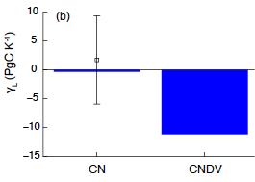
Forest Dynamics and the Nitrogen Cycle: Understanding Plant Response to Atmospheric CO₂
Objective
Understand how coupled dynamic vegetation-nitrogen cycle affects carbon-cycle feedback loops
Approach
Compare simulations with dynamic vegetation and simulations with static vegetation cover using a global land model with coupled carbon-nitrogen cycle (Community Land Model version 4)
Systematically analyze how the simulated land carbon responds to warming and CO₂ increase, individually and together
prescribed
dynamic
ABOVE: Significant difference found between static and dynamic vegetation in how much carbon is lost for a 1ºC temperature increase
RIGHT: Difference in forest cover (top two panels) and resulting nitrogen demand and production difference
N production
Impact
This study provides important evidence for how dynamic vegetation and the nitrogen cycle may affect the strength of carbon-cycle feedback loops and inform earth system model development needs
Sakaguchi K, X Zeng, LR Leung, and P Shao. 2016. “Influence of Dynamic Vegetation on Carbon-Nitrogen Cycle Feedback in the Community Land Model (CLM4).” Environmental Research Letters 11. DOI: 10.1088/1748-9326/aa51d9
Notes:
http://www.pnnl.gov/science/highlights/highlights.asp?division=749

