Slide 1
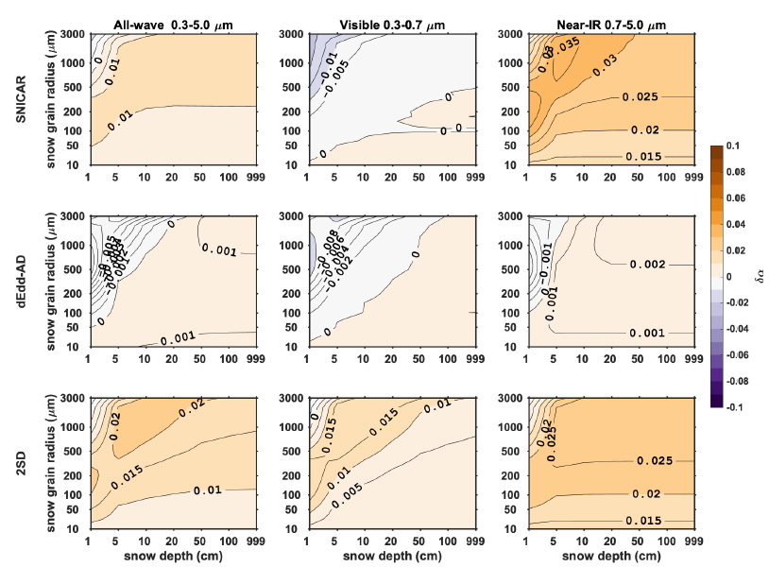
New shortwave radiative transfer module SNICAR-AD
improves E3SM-simulated snow radiative properties
Objective
Unify default snow shortwave radiative transfer modules implemented MPAS-seaice and ELM;
Improve simulation of snow shortwave radiative properties.
Key results
ELM underestimates diffuse snow albedo and over estimate diffuse solar absorption (Figure);
MPAS-seaice may generate large biases in snow albedo by adopting adjusted snow grain radius;
Both MPAS-seaice and ELM underestimate direct snow albedo for solar zenith angles larger than 75 degrees.
SNICAR-AD
Based on these findings, we formulate a universal radiative transfer scheme SNICAR-AD, which is implemented in MPAS-seaice and ELM of E3SM v2, to provide a consistent and improved simulation on snow solar radiative properties.
The code can be found in E3SM master branch:
https://github.com/E3SM-Project/E3SM.git
Figure. The difference in diffuse snow albedo (δα = α₂ – α₁₆) computed using two-stream models in E3SM (α₂) and using 16-stream benchmark model (α₁₆ ), for various snow depths and snow grain radii, with solar zenith angle of 60° at the top of the atmosphere.
Dang, C., Zender, C. S., and Flanner, M. G.: Intercomparison and improvement of two-stream shortwave radiative transfer schemes in Earth system models for a unified treatment of cryospheric surfaces, The Cryosphere, 13, 2325–2343, https://doi.org/10.5194/tc-13-2325-2019, 2019.

