Slide 1
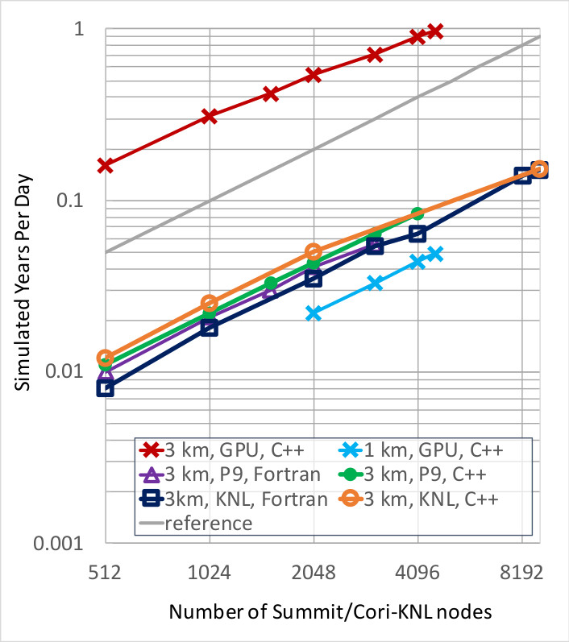
HOMMEXX-NH: a performance-portable non-hydrostatic atmosphere dycore for E3SM
Scientific Challenge
E3SM’s non-hydrostatic dynamical core (HOMME-NH) is highly performant on CPU, but lacked GPU implementation, which is crucial to achieve E3SM’s goal of resolving cloud-scale features on upcoming Exacale systems. Our objective is to develop a performance portable version of HOMME-NH which can efficiently run on a variety of HPC architectures, including conventional CPUs, many-core CPUs, as well as GPUs.
Approach and results
Use C++ library Kokkos to manage on-node threaded parallelism.
Testing: run the National Weather Service’s computational performance benchmark problem at cloud resolving resolutions.
Scaling: excellent at 3km resolution, perfect at 1km resolution.
Achieve 0.97 SYPD when running on GPU, on the full Summit system.
Approximately 10x speedup when using GPUs vs P9 CPUs on Summit. Impact/significance
Record-setting performance of 0.97 SYPD on a realistic cloud-resolving community benchmark.
Lay groundwork for physics parametrizations to be implemented in a similar framework, which will permit running some of the first decade long cloud-resolving climate simulations.
L. Bertagna, O. Guba, M.A. Taylor, J.G. Foucar, J. Larkin, A.M. Bradley, S. Rajamanikam, A.G. Salinger, A Performance-Portable Nonhydrostatic Atmospheric Dycore for the Energy Exascale Earth System Model Running at Cloud-Resolving Resolutions, SC ’20: Proceedings of the International Conference for High Performance Computing, Networking, Storage and Analysis, Nov. 2020. (doi: 10.1109/SC41405.2020.00096)
SAND2021-6454 O

