Slide 1
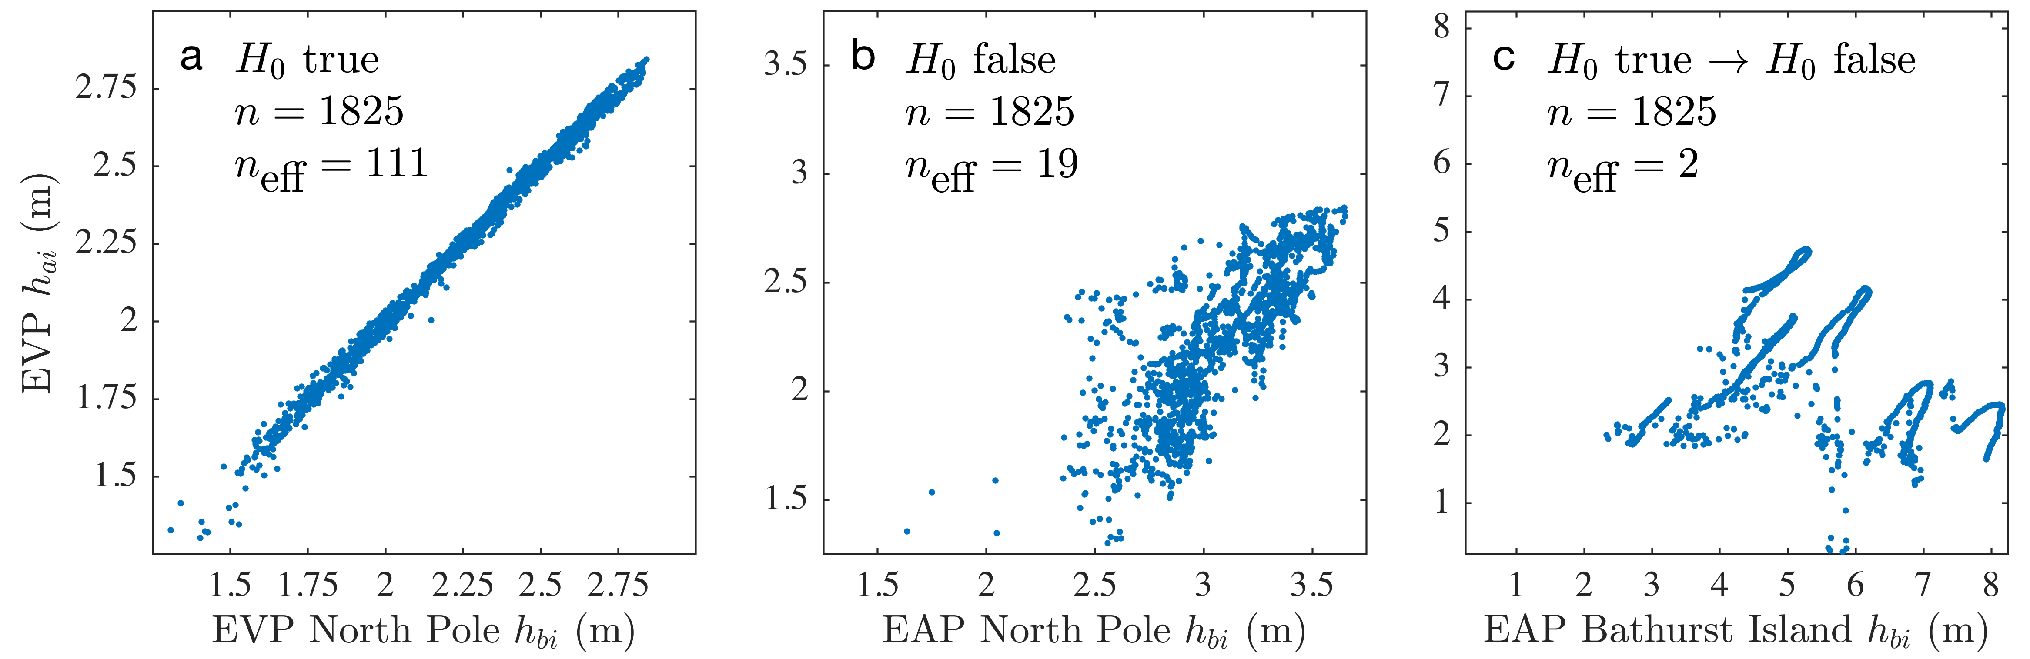
Quality Control for Community Based Sea Ice Model Development
Demonstration of the Two-Stage Paired Thickness Test for daily concentration-weighted ice thickness series from the Regional Arctic System Model (RASM), a fully coupled model that uses CICE as the sea ice component. Statistical tests (a) confirm the null hypothesis for adjacent grid cells using identical code, (b) confirm that simulations using different rheologies differ statistically, and (c) correct an initially incorrect result due to autocorrelation of the time series in low-variance regions.
Objectives
Avoid inadvertent bugs or numerical inaccuracies in new code contributed to the CICE repositories
Create efficient quality control procedures for classifying the degree to which code changes affect the CICE sea ice model solution, including the Icepack module used in E3SM and RASM
Implement and automate the procedures in CICE scripts
Approach
Test the null hypothesis using specialized t-tests over the Arctic and Antarctic sea ice zones
Categorize the change based on the spatial extent of widespread differences from baseline integrations
If the new CICE code passes, use a second skill metric to check for high correlation and matching variance with the benchmark integrations
Impact
Objective, statistical tests allow code modifications to be quickly evaluated for potential bugs and numerical issues
Automated testing enables community participation in sea ice model development using standardized metrics
The metrics also provide objective guidance for assessing new physical representations and code functionality
Roberts, A. F., E. C. Hunke, R. Allard, D. A. Bailey, A. P. Craig, J-F. Lemieux, M. D. Turner (2018): Quality Control for Community Based Sea Ice Model Development, Philos. Trans. Royal Soc. A, accepted, doi:10.1098/rsta.2017.0344.

