Slide 1
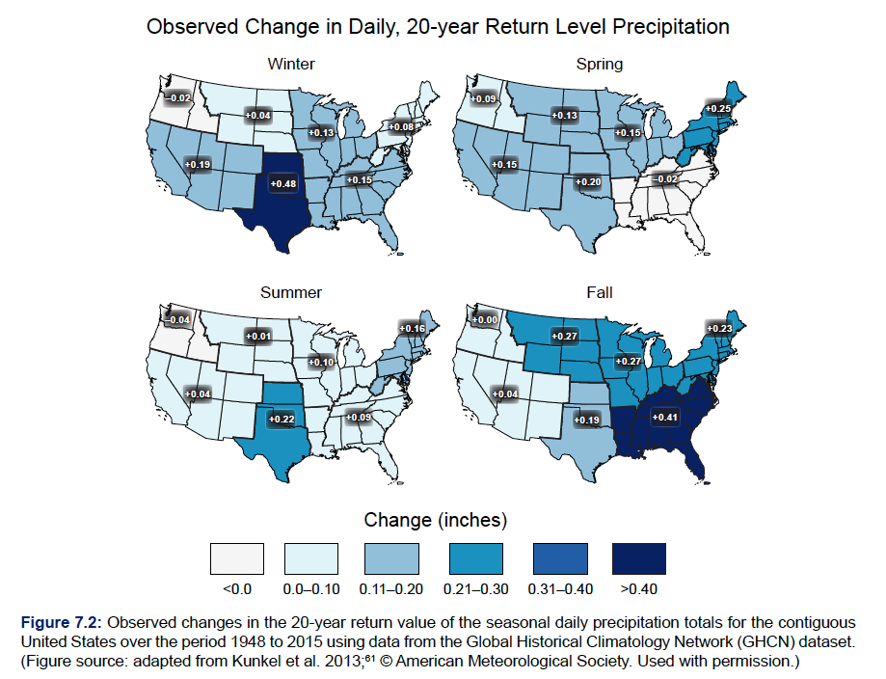

Detected changes in precipitation extremes at their native scales derived from in situ measurements
Kunkel et al. (2013) analysis
A specialized spatial extreme value analysis is used to characterize trends in the climatology of extreme precipitation over CONUS as follows: (1) estimate extreme precipitation statistics based on station data, (2) use a data-driven approach to interpolate trends, (3) quantify resulting uncertainty, and (4) robustly determine statistical significance.
We translate trends in extreme precipitation from in situ measurements to a high-resolution grid over CONUS, finding significant changes in SON but few meaningful changes in other seasons (see figure on left). Furthermore, we resolve the changes to their native scales, which provides important local information that is relevant for impacts.
Observed changes in the 20-year return value (inches/70 years) based on GHCN station data: the analysis in this paper (left), with significance hatching, versus an analysis shown in the National Climate Assessment (right).
Note: our results present important local information – what looks like no change in Fall from Kunkel et al. in the Southwest is actually the combination of large increases in New Mexico and large decreases in California.
Analyses conducted using state-of-the-art extreme value statistical methods
Data-driven uncertainty quantification to indicate where trends are significantly different from zero
Accounts for seasonal differences in the climatology of extreme precipitation
Main result is on seasonal changes, but we also derive a metric for characterizing annual changes in the statistics of extremes
Risser, M.D., C.J. Paciorek, T.A. O’Brien, M.F. Wehner, and W.D. Collins, (2019): Detected changes in precipitation extremes at their native scales derived from in situ measurements. J. Climate, 0, https://doi.org/10.1175/JCLI-D-19-0077.1

