Slide 1
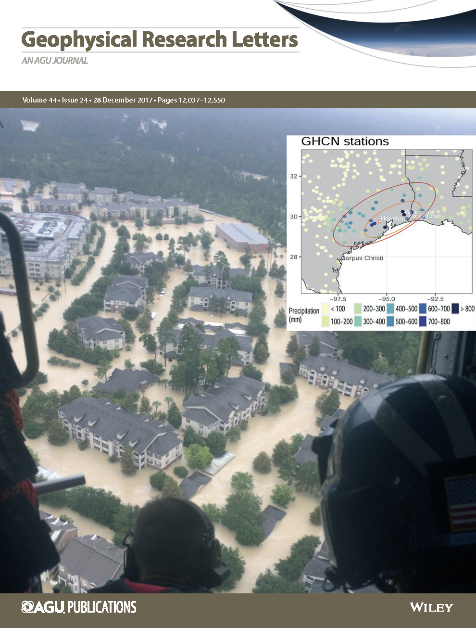
Attributable Human‐Induced Changes in the Likelihood and Magnitude of the Observed Extreme Precipitation during Hurricane Harvey
A specialized extreme value statistical analysis is used to characterize historical trends in severe storms in the Houston, TX area. The analysis accounts for both natural and human influences on severe storms during hurricane season in the Gulf Coast region and systematically quantifies uncertainty in the features of these storms.
Our analysis identifies significant increases in the magnitude (at least 19% stronger) and likelihood (at least 3.5 times more likely) of a storm like Hurricane Harvey, and that these changes are attributable to human-induced climate change. Changes in the storm are much larger than expected, motivating further study of the event.
Analyses conducted using state-of-the-art extreme value statistical methods
Methodology explicitly separates the effects of human and natural influences on severe storms
Confidence statements made within the framework of IPCC guidelines
Lays a foundation for attribution statements based only on observational data using Granger causality
Cover Issue of Dec. 2017 Geophysical Research Letters, featuring a figure from this paper. (Inset figure: precipitation totals during Hurricane Harvey).
Risser, M. D., & Wehner, M. F. (2017). “Attributable human-induced changes in the likelihood and magnitude of the observed extreme precipitation during Hurricane Harvey.” Geophysical Research Letters, 44, 12,457–12,464. https://doi.org/10.1002/2017GL075888

