Slide 1
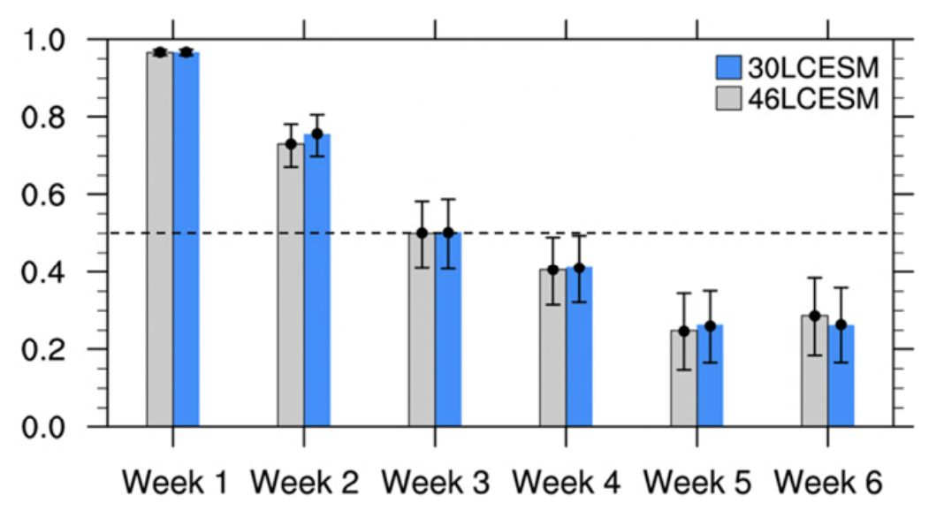
Subseasonal Prediction with and without a Well-Represented Stratosphere in CESM1
JH Richter , .. , JM Caron, A. Glanville and Others (2020): Weather and Forecasting: https://doi.org/10.1175/WAF-D-20-0029.1
OBJECTIVE
To evaluate whether a better represented stratosphere improves subseasonal prediction of surface temperature and precipitation as well as the NAO and the MJO
ACC of NAO
APPROACH
We examined week 3-4 averaged prediction skill of temperature, precipitation, MJO and NOA in S2S hindcasts carried out with two versions of CESM1: one with (46-level) and one without (30-level) a well-resolved stratosphere
IMPACT
There is a growing demand in society for understanding sources of predictability on subseasonal to seasonal time scales. In this work we demonstrate that CESM1 has subseasonal prediction skill comparable to the NOAA operational model. We find that a better-resolved stratosphere improves the prediction skill of the stratosphere for week 3-4, however there is no improvement of surface prediction skill at this timescale.
ACC of the weekly mean NAO at increasing lead times during NDJFM for 30LCESM (blue bars) and 46LCESM (gray bars). Error bars indicate the 5% and 95% statistical levels based on bootstrapping.

