Slide 1
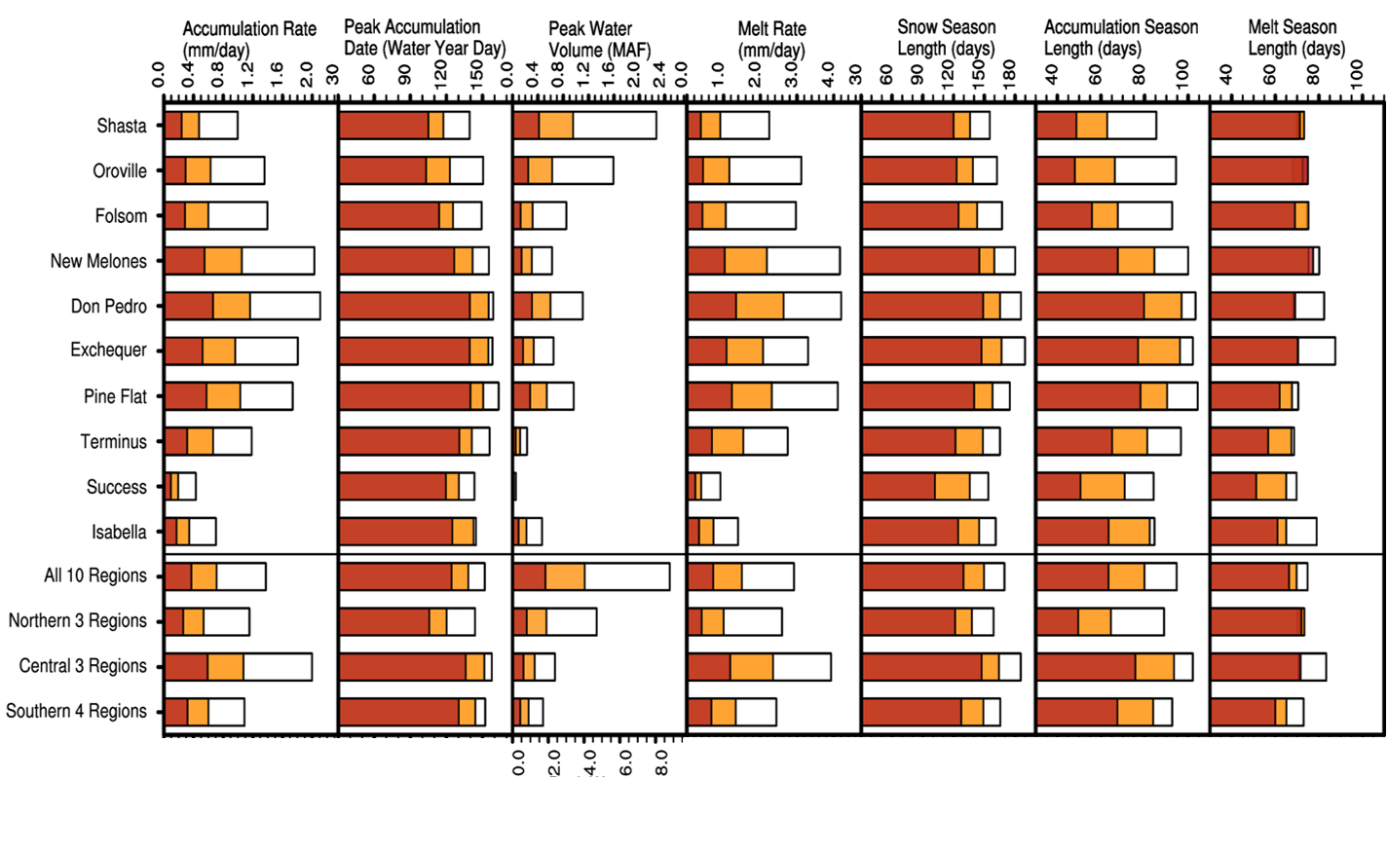
The Changing Character of the California Sierra Nevada as a Natural Reservoir
Scientific Achievement
Research Details
The historical role of California’s Sierra Nevada mountain snowpack as a steady source of fresh water will fade due to climate change. In this paper we aim to answer four major questions surrounding the regional spatiotemporal change in Sierra Nevada mountain snowpack such as how it may change in the headwater regions of major surface reservoirs, the latitudinal and elevational dependencies of this change, and how the choice of regional climate model influences future projections. These questions are answered through the use of a use-inspired multi-metric framework developed through ongoing scientist-stakeholder interaction in Project Hyperion and applied on a multi-model ensemble.
Nine of the North American Coordinated Regional Climate Downscaling Experiment (NA-CORDEX) simulations are assessed over a 20-year historical, mid century, and end century period upstream of 10 of California’s major reservoirs.
The ensemble average of the nine NA-CORDEX simulations show that by end-century SWE peak timing may occur 4 weeks earlier coupled with a 79.3% reduction in peak water volume upstream of 40% of California’s surface water storage.
The largest reductions are above Shasta, Oroville, and Folsom and between 0- and 2,000-m elevations.
Although regional climate model resolution had some impact on the historical representation and projected change in snowpack, regional climate model choice and global forcing data set had more of an impact.
7 measures of simulated snowpack change at
mid-century and end-century
under a high-emissions scenario
Significance and Impact
The California Sierra Nevada acts like a natural water tower that stores snowpack in winter and releases it as snowmelt during spring to summer. However, climate change has and continues to undermine this natural service. This work provides detailed guidance on the mountain snow conditions policymakers, water managers, and scientists will encounter in addressing adaptive resiliency for California’s water supply system.
Citation: Rhoades, A. M., Jones, A. D., and Ullrich, P. A. (2018). “The changing character of the California Sierra Nevada as a natural reservoir” Geophysical Research Letters, 45. https://doi.org/10.1029/2018GL080308.

