Slide 1
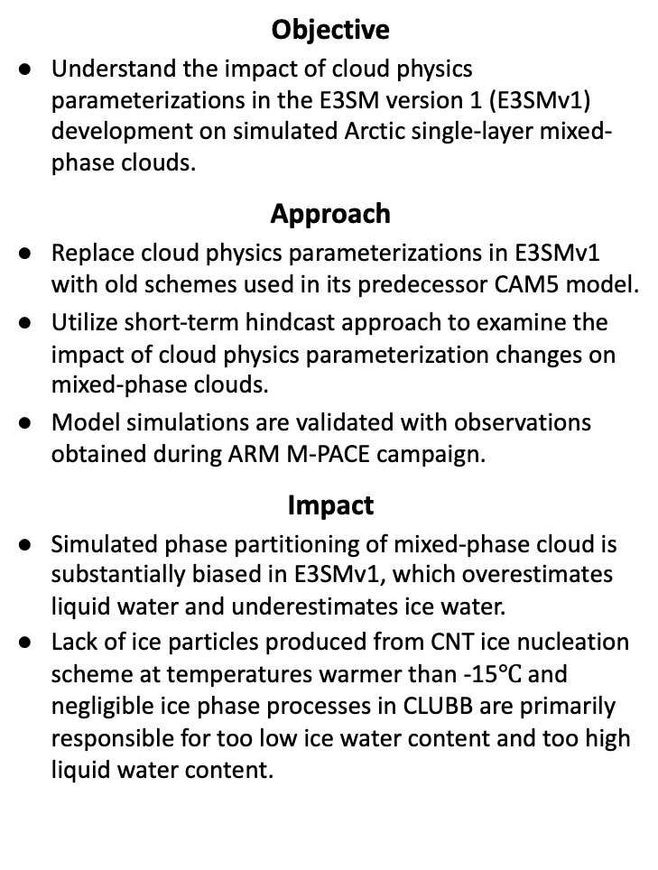
Understanding the simulated phase partitioning of Arctic single-layer mixed-phase clouds in E3SM
Objective
Understand the impact of cloud physics parameterizations in the E3SM version 1 (E3SMv1) development on simulated Arctic single-layer mixed-phase clouds.
Approach
Replace cloud physics parameterizations in E3SMv1 with old schemes used in its predecessor CAM5 model.
Utilize short-term hindcast approach to examine the impact of cloud physics parameterization changes on mixed-phase clouds.
Model simulations are validated with observations obtained during ARM M-PACE campaign.
Impact
Simulated phase partitioning of mixed-phase cloud is substantially biased in E3SMv1, which overestimates liquid water and underestimates ice water.
Lack of ice particles produced from CNT ice nucleation scheme at temperatures warmer than -15$℃$ and negligible ice phase processes in CLUBB are primarily responsible for too low ice water content and too high liquid water content.
Time series of liquid water path and ice water path from E3SM and the ARM ACRED dataset between 9-15 October. CTL is the default E3SMv1, MEYERS uses Meyers ice nucleation scheme, UW uses University of Washington schemes to replace CLUBB turbulence, and UW_MG1 uses MG1 to replace MG2 cloud microphysics in UW experiment.
Zhang, M., Xie, S., Liu, X., Lin, W., Zhang, K., Ma, H.‐Y., Zheng, X., & Zhang, Y. (2020). Toward Understanding the Simulated Phase Partitioning of Arctic Single‐Layer Mixed‐Phase Clouds in E3SM. Earth and Space Science, 7, e2020EA001125. https://doi.org/10.1029/2020EA001125
Notes:
http://www.pnnl.gov/science/highlights/highlights.asp?division=749

