Slide 1
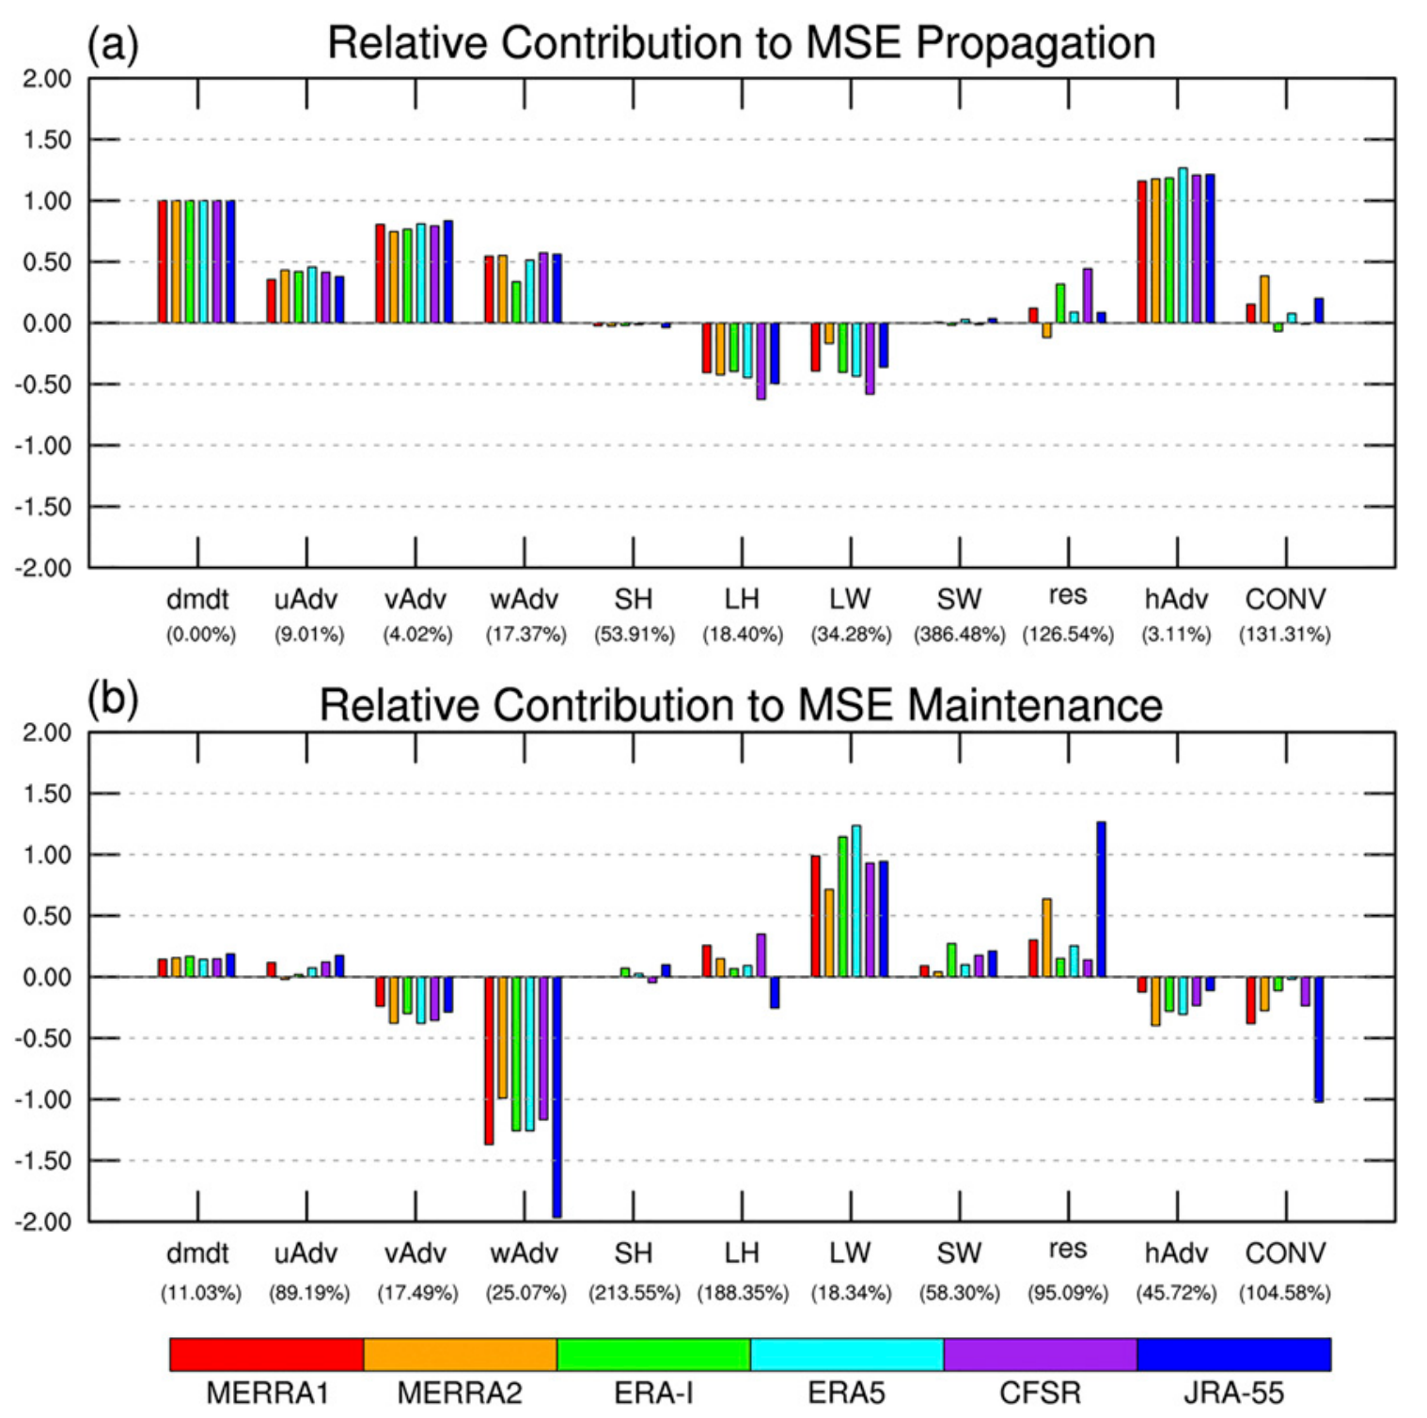
Intercomparison of MJO Column Moist Static Energy and Water Vapor Budget among Six Modern Reanalysis Products
Ren, P., D. Kim, M.-S. Ahn, D. Kang, and H.-L. Ren, 2021: Intercomparison of MJO Column Moist Static Energy and Water Vapor Budget among Six Modern Reanalysis Products. J. Clim., 34, 2977–3001, https://doi.org/10.1175/JCLI-D-20-0653.1
Objective
﻿﻿The main objective of this study is to document how similarly or differently the processes that are key to MJO propagation and maintenance are represented in the ﻿reanalysis products (RAs)
Approach
Use the ﻿six modern RAs: MERRA-1, MERRA-2, ERA-I, ERA5, CFSR, and JRA-55
Analyze and compare the MJO ﻿﻿column-integrated moist static energy (MSE) and ﻿column water vapor (CWV) budget as well as the relevant mean state
Impact
﻿﻿﻿Notable inter-RA differences were found in the horizontal and vertical gradient of the mean MSE, which affects the MSE budget through the corresponding advection terms
﻿The MSE budget terms directly affected by the model parameterization schemes exhibit high uncertainty
Figure. ﻿Normalized contribution of the individual terms in the column-integrated MSE budget to the (a) propagation and (b) maintenance of MJO MSE anomalies over the domain 15S–15N, 60–180E, and MJO phases 1–8. The individual budget terms shown include, from left to right, MSE tendency (dmdt), zonal MSE advection (uAdv), meridional MSE advection (vAdv), vertical MSE advection (wAdv), surface sensible heat fluxes (SH), surface latent heat fluxes (LH), column longwave radiative heating (LW), column shortwave radiative heating (SW), the budget residual (res), the sum of zonal MSE advection and meridional MSE advection (hAdv), and the sum of longwave heating and vertical MSE advection (CONV). The numbers in parentheses indicate a measure of the inter-RA spread, which is obtained for each budget term by dividing the standard deviation of values from six RAs by the absolute value of its corresponding MRM value. The resulting number is shown as a percentage.

