Slide 1
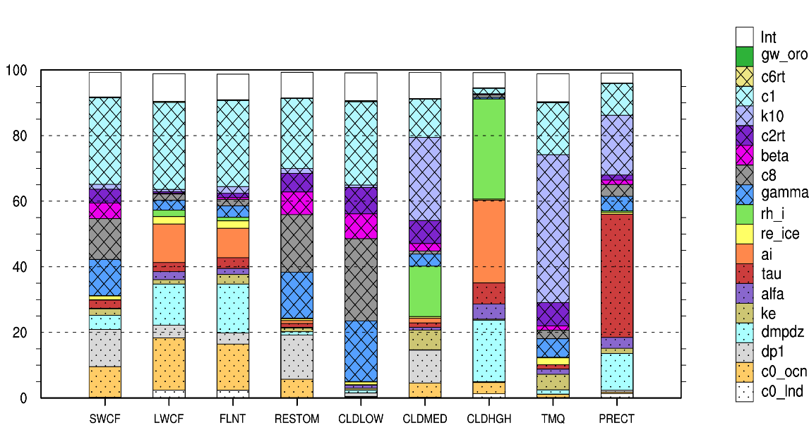
Parametric Sensitivity and Uncertainty Quantification in the E3SM Atmosphere Model
Objective
Improve understanding of model behavior and quantify uncertainty in the atmospheric component of DOE’s Energy Exascale Earth System Model (E3SM) version 1 (EAMv1)
Approach
Select and simultaneously perturb 18 parameters that could significantly influence EAMv1’s representation of cloud microphysics, turbulence, and convection
Conduct 256x12 ensemble short simulations at modest cost and within short wall clock time (five days) on DOE Leadership Computers
Impact
Study provides a comprehensive picture of the behaviors of EAMv1 and its sensitivity to model parameters
Perturbed parameter ensemble (PPE) using short simulations has some bearing on understanding parametric sensitivity of longer simulations
Difficulty in reducing biases simultaneously in multiple variables highlights structural uncertainty and the need of characterizing embedded errors to inform future development efforts
Perturbed parameters
Relative contributions
Objective atmospheric variables
The relative contributions—importance—of 18 parameters and their interactions for nine objective variables.
Qian Y, H Wan, B Yang, J-C Golaz, B Harrop, Z Hou, VE Larson, LR Leung, G Lin, W Lin, P-L Ma, H-Y Ma, P Rasch, B Singh, H Wang, S Xie, and K Zhang. 2018. “Parametric Sensitivity and Uncertainty Quantification in the Version 1 of E3SM Atmosphere Model Based on Short Perturbed Parameter Ensemble Simulations.” Journal of Geophysical Research: Atmospheres 123(23):13,046−13,073. https://doi.org/10.1029/2018JD028927
Notes:
http://www.pnnl.gov/science/highlights/highlights.asp?division=749

