Slide 1
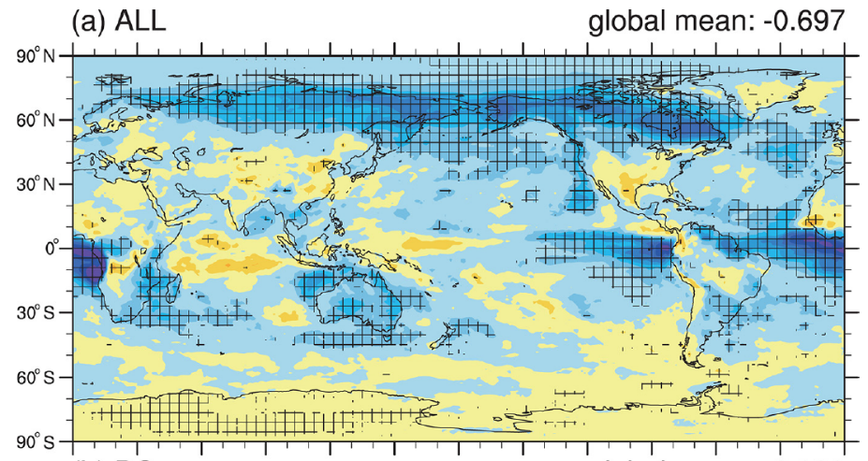
Global Impact of Open-Fire Aerosols on Clouds and Radiation
Objective
Investigate the spatial and seasonal characteristics
of radiative effects of open-fire aerosols including black carbon and particulate organic matter
Approach
Perform ensemble CAM5 model simulations with and without open-fire emissions
Diagnose fire aerosol effects through aerosol-radiation interaction and aerosol-cloud interaction separately
Annual mean fire aerosol effects on radiation at TOA (W m⁻²) during period of 2003-2011.
Impact
By quantifying the energy imbalance of fire aerosols, results reduce uncertainties about feedback mechanisms between open fire and climate interactions
Fire aerosols have a significant impact on the global annual mean net radiation at TOA (-0.70 W m⁻²)
Fire aerosol effects on radiation in the Northern Hemisphere (NH) high-latitude regions are stronger than in other regions (e.g., the tropics) despite a smaller fire aerosol load
Jiang Y, Z Lu, X Liu, Y Qian, K Zhang, Y Wang, and X-Q Yang. 2016. “Impacts of Global Open-Fire Aerosols on Direct Radiative, Cloud and Surface-Albedo Effects Simulated with CAM5.” Atmospheric Chemistry and Physics 16:14805-14824. DOI: 10.5194/acp-16-14805-2016
Notes:
http://www.pnnl.gov/science/highlights/highlights.asp?division=749

