Slide 1
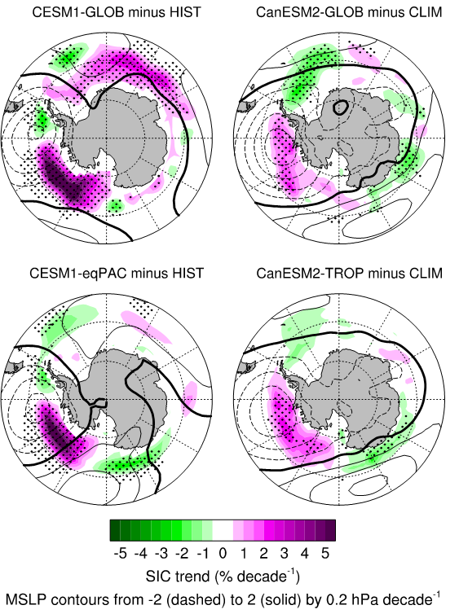


Tropical Pacific SST drivers of recent Antarctic sea ice trends
Objective: The seemingly counter-intuitive observed increase of Antarctic sea ice extent in the face of a warming planet is further explored to follow up on other related studies in order to use model simulations to explore processes
Anomalies of sea level pressure (contours) and sea ice concentration (colors) from CESM1 and CanESM2 forced with global observed ocean conditions (top panels) and only with equatorial Pacific (for CESM1) or global tropics (for CanESM2) (bottom panels) showing that the observed signature of a deeper Amundsen Sea Low (dashed contours in southeast Pacific) and increased sea ice (purple colors) that result from global ocean forcing (top panels) can be produced from just the negative IPO phase in the tropical Pacific (bottom panels)
Research:
--a strengthening of the Amundsen Sea Low in the southeast Pacific from 1979-2013 largely explains the observed increase in sea ice concentrations
--these changes are not generally seen in freely-running coupled earth system model simulations, but they are reproduced in simulations constrained by observed sea surface temperature anomalies in the tropical Pacific, and by observed surface wind-stress in the tropics
--simulated trends in spatial patterns of increasing sea ice concentrations are similar to observed
Impact: Analysis confirms previous results and strengthens the conclusion that the phase change in the Interdecadal Pacific Oscillation from positive to negative over 1979-2013 contributed to the observed strengthening of the Amundsen Sea Low and associated increase of Antarctic sea ice extent
Purich, A., M.H. England, W.Cai, Y. Chikamoto, A. Timmermann, J.C. Fyfe, L. Frankcombe, G.A. Meehl, and J.M. Arblaster, 2016: Tropical Pacific SST drivers of recent Antarctic sea ice trends. J. Climate, 29, 8931-8948, doi:10.1175/JCLI-D-0440.1.

