Slide 1
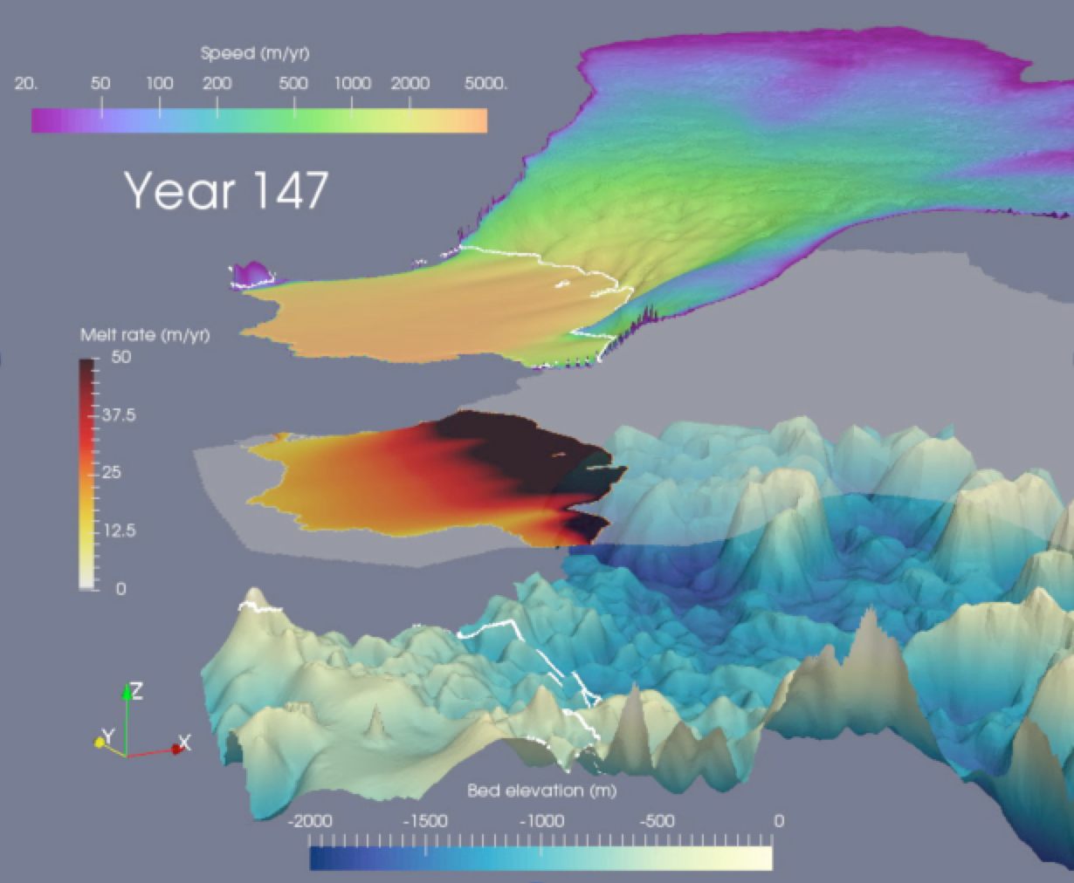
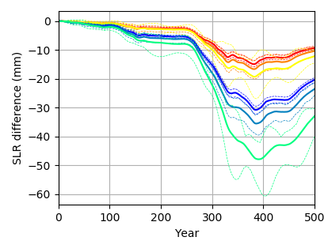
Variability in ocean temperatures causes delays in glacier retreat
Objective
Climate exhibits substantial internal variability, but existing ice sheet model simulations projecting sea level rise ignore this. How will the inclusion of climate variability affect the evolution of West Antarctica where unstable ice retreat is underway?
Left: Example model output showing ice speed (top), applied melt rate (middle), and bed topography (bottom) during one simulation.
Research
Performed 500 year model simulations of Thwaites Glacier, Antarctica (1.5 m sea level rise potential) using DOE’s MALI ice sheet model
Developed a new parameterization of sub-ice shelf melting forced by warm ocean waters
Compared control run with no variability to 72 ensembles with idealized variability in ocean temperature and sub-ice shelf melting
Found up to 10% less sea level rise from Thwaites Glacier when including ocean variability
Above Right: Difference in sea level rise when ocean temperature variability is included in simulations. Warm colors are moderate magnitude variability with different frequencies. Cool colors are high magnitude variability.
Impact
Ice sheet model projections of sea level rise ignoring real-world climate variability are too large. Coupling ice sheet models to climate models will lead to more accurate sea level projections.
Reference: Hoffman, M. J., Asay-Davis, X., Price, S. F., Fyke, J. and Perego, M. 2019. Effect of Subshelf Melt Variability on Sea Level Rise Contribution From Thwaites Glacier, Antarctica, J. Geophys. Res. Earth Surf., 124, 1–24, doi:10.1029/2019JF005155,

