Slide 1
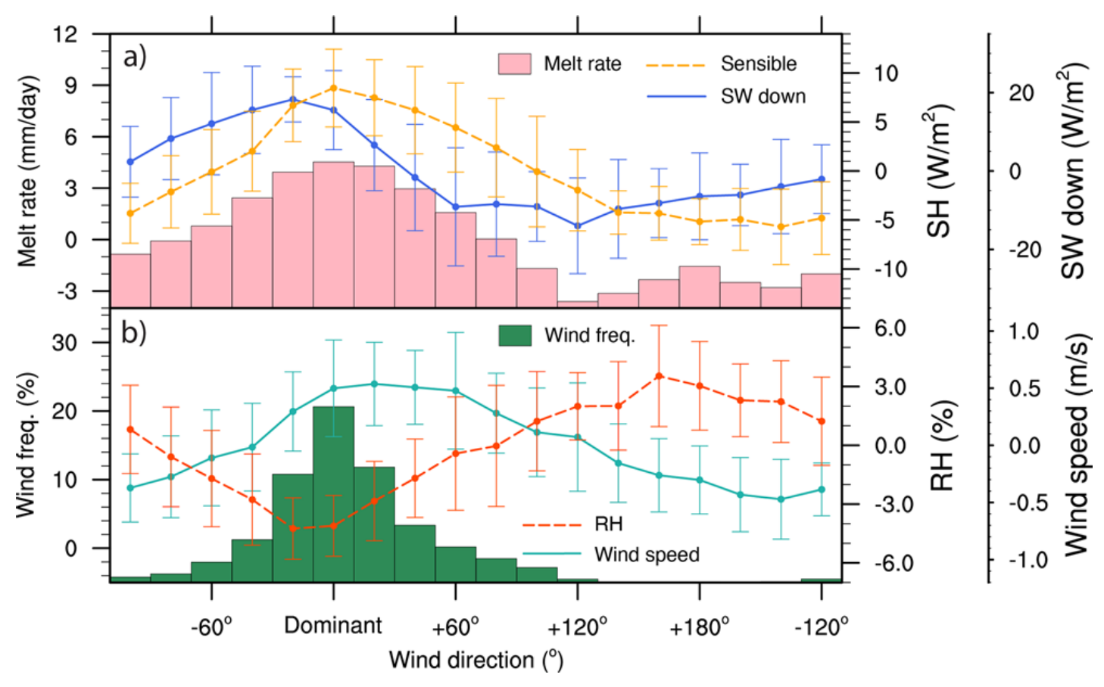
Greenland surface melt dominated by solar and sensible heating
Objective: Identify the dominant energy components and the associated physical processes for Greenland’s surface melt
Approach: Examine the longest in-situ measurements of surface energy budget and meteorology from automatic weather stations throughout the ablation zone of Greenland
Impact
  Our study is the most comprehensive investigation of surface ablation processes on the Greenland Ice Sheet based on decade-long in-situ measurements
  Our findings indicate that solar and sensible heating rather than longwave heating (the currently prevailing hypothesis) contribute the most to Greenland’s surface melt
  Since high-melt regions along the ice sheet margins will typically have relatively steep slopes, this wind-driven melt mechanism will continue to have a large impact on Greenland’s surface melt in the future.
Fig. Anomalies (against station averages) of a) melt rate (pink histogram), sensible heat (yellow line), and insolation (blue line); b) wind frequency (green histogram), relative humidity (orange line), and wind speed (green line) binned by wind-from directions. Values are binned in 20-degree increments relative to the dominant wind direction of each station. Error bars represent plus/minus one standard deviation.

