Slide 1
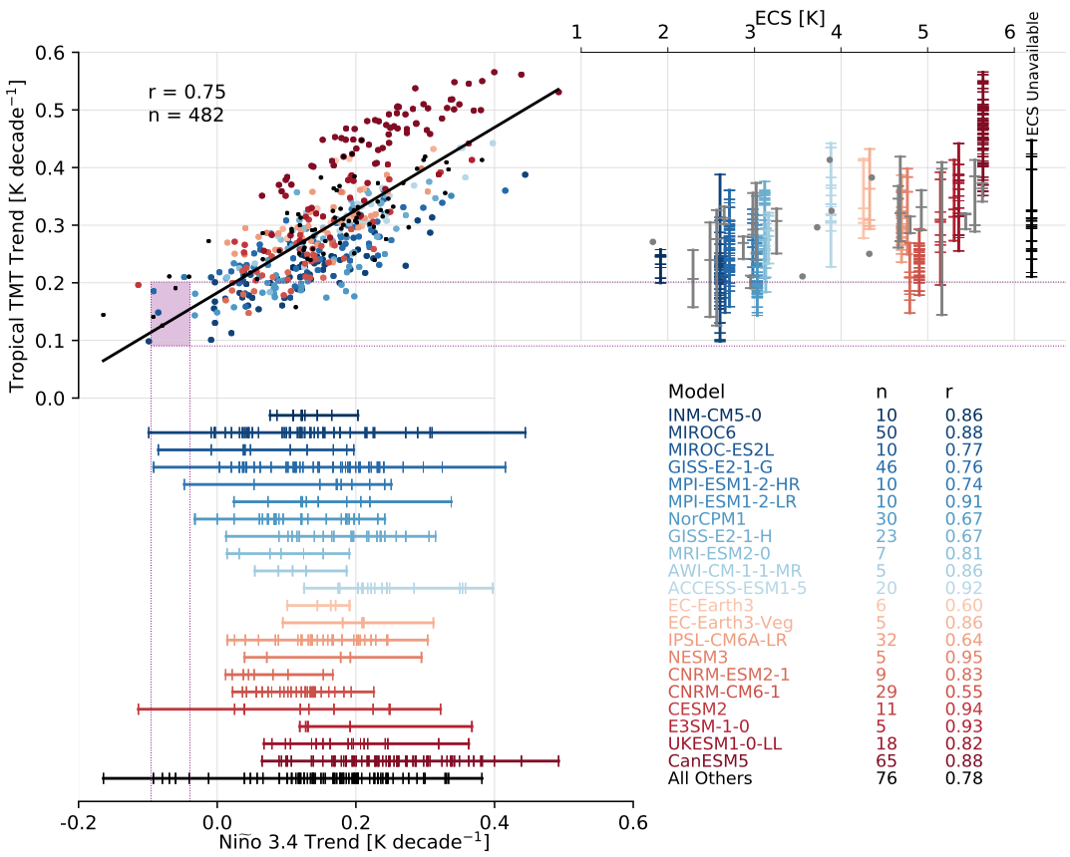
Natural variability helps to explain the gap between atmospheric warming in satellite observations and climate models
Problem
On average, climate models exhibit much greater tropical tropospheric warming than satellite observations
Results
Natural climate variability has reduced the rate of observed tropical tropospheric warming
Model simulations with both high and low climate sensitivity values can reproduce satellite observed trends when simulated climate variability is consistent with observations
Conclusions and Impact
This work demonstrates that satellite observations and the latest generation of climate models are not inconsistent
Multidecadal variability must be accounted for when assessing model climate sensitivity using the historical record
Reference: Po-Chedley, S., B. D. Santer, S. Fueglistaler, M. D. Zelinka, P. J. Cameron-Smith, J. Painter, and Q. Fu, 2021: Natural variability contributes to model-satellite differences in tropical tropospheric warming, Proc. Nat. Acad. Sci., in press.
Notes:
Figure Explanation: Individual models exhibit a wide range of surface warming trends (1979 – 2014) in the central Pacific (horizontal lines in lower left). This translates into a wide range of tropical tropospheric warming in individual model ensembles due to natural climate variability (scatter plot in the upper left and vertical lines in the upper right). Although tropical tropospheric warming does scale with climate sensitivity (ECS, upper right), models with both high and low climate sensitivity have individual realizations that are in accord with observed trends (dashed horizontal horizontal purple lines), which have been suppressed due to diminished central Pacific warming (purple box in upper left) and a La Nina like warming pattern (now shown).
Caption: Tropical mid-tropospheric (TMT) trend (1979 - 2014) versus the central Pacific (Nino 3.4) region SST trend for 482 CMIP6 historical simulations. Models are color-coded based on ECS, with the lowest ECS values in dark blue and highest ECS values in dark red. The range of observational values is denoted by the purple box. Horizontal lines indicate the range of Nino 3.4 trends for individual models with 5 or more ensemble members. The legend also provides the number of ensemble members, n, and the correlation coefficient, r, between the Nino 3.4 and tropical TMT trends for each model. The right side of the figure provides a similar color-coded display of the range of tropical TMT trends plotted against ECS (abscissa). Models with more than one ensemble member are displayed as vertical lines and models with only one ensemble member are denoted with dots.

