Slide 1
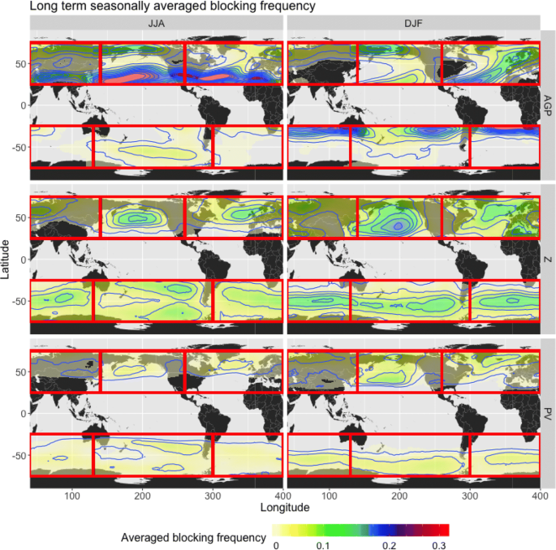
Understanding Differences in Objective Identification of Atmospheric Blocking
We show that careful consideration of the algorithm biases in objective tracking methods is important in assessing change in atmospheric blocking. Differences in the definition of blocking produced widely varying climatologies, underscoring that different processes are relevant in different regions for connecting blocks to extreme weather.
Figure: Long-term seasonally-averaged (JJA and DJF) blocking frequency from three different detection methods.
Atmospheric blocks are obstructions to the normal flow pattern of the atmosphere, often associated with heat waves and modified precipitation patterns. Several objective methods for identifying blocks are examined and intercompared to understand how these differences could affect scientific conclusions related to atmospheric blocking.
Three different atmospheric blocking detection algorithms were examined to understand the characteristics of the blocking climatology from each algorithm.
Characteristics of the blocks were examined and compared, including geographic location, intensity, speed, region, and associated meteorological features.
Differences among different blocking algorithms could drive different scientific conclusions by region.
Pinheiro, M.C., P.A. Ullrich, and R. Grotjahn (2019) "Atmospheric blocking and intercomparison of objective detection methods: Flow field characteristics" Clim. Dyn. 53, pp. 4189–4216, doi: 10.1007/s00382-019-04782-5.

