Slide 1

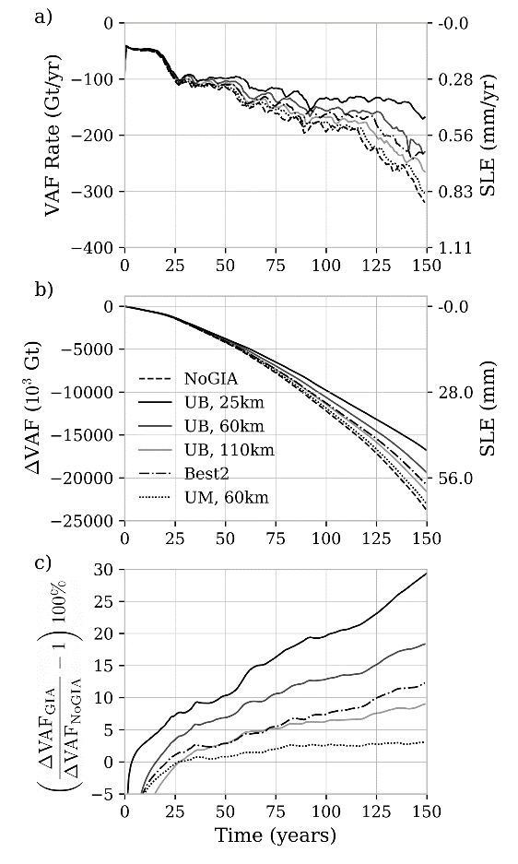



Rapid Viscoelastic Deformation Slows Marine Ice Sheet Instability at Pine Island Glacier, West Antarctica
Scientific Achievement
  We examine the feedback between ice sheet
  dynamics and solid-earth viscoelastic response
  and its impact on grounding-line (GL) stability
  and sea level rise (SLR).
Significance and Impact
  Solid-earth feedbacks, from viscoelastic
  glacial isostatic adjustment (GIA) in response to
  unloading from ice sheet thinning, have the
  potential to mitigate GL retreat and mass loss
  due to marine ice sheet instability.
  Full dynamic coupling of a viscoelastic solid-earth
  deformation model to the DOE-supported BISICLES
  ice sheet model in a new GIANT-BISICLES model.
  Bedrock uplift due to the viscoelastic response of a
  low-viscosity mantle can rapidly reduce ocean
  depth near the grounding line and stabilize the
  marine ice sheet instability over decades to centuries.
  Viscoelastic uplift on timescales similar to grounding
  line migration can be a leading term in determining
  rates of SLR due to the marine ice sheet instability.
Research Details
  Coupled solid-earth/ice sheet model used to simulate West Antarctica’s Pine Island Glacier for a range of potential mantle viscosities.
  Uses DOE SciDAC-supported BISICLES adaptive mesh refinement (AMR) ice sheet model which resolves flow down to 500m resolution, essential for accurately capturing realistic grounding line dynamics.
Uplift (m)
Top: Viscoelastic uplift of the grounding line (GL) slows retreat. The regional uplift at three times: t=50, 100, and 150 years for model with solid-earth response, also showing the initial GL (dotted) and predicted GL with uplift (GIA -solid) and without uplift (NoGIA - dashed) contours shown. The maximum uplift is predicted just in front of the grounding line.
Right: Results from coupling Pine Island Glacier flow to
GIA-related deformation over 150 years for different rheologies. a) Volume above flotation (VAF) loss rate in Gigatons of ice and millimeters of equivalent sea level rise (SLE). b) Change in total VAF (∆VAF) relative to t=0. c) Percentage difference ∆VAF (from b) between models with GIA-related deformation relative to without.
Kachuck, Martin, Bassis, and Price (2020). Geophysical Research Letters, DOI 10.1029/2019GL086446. Contact: Samuel Kachuck (skachuck@umich.edu)
Notes:
Code: Glacial Isostatic Adjustment-ANTarctic BISICLES (GIANT-BISICLES) available from the BISICLES SVN repo (see below)
Abstract: The ice sheets of the Amundsen Sea Embayment (ASE) are vulnerable to the marine ice sheet instability (MISI), which could cause irreversible collapse and raise sea levels by over a meter. The uncertain timing and scale of this collapse depend on the complex interaction between ice, ocean, and bedrock dynamics. The mantle beneath the ASE is likely less viscous ($\sim10^{18}$ Pa s) than the Earth's average mantle ($\sim10^{21}$ Pa s). Here we show that an effective equilibrium between Pine Island Glacier's retreat and the response of a weak viscoelastic mantle can reduce ice mass lost by almost 30\% over 150 years. Other components of solid-Earth response -- purely elastic deformations, geoid perturbations -- provide less stability than the viscoelastic response alone. Uncertainties in mantle rheology, topography, and basal melt affect how much stability we expect, if any. Our study indicates the importance of considering viscoelastic uplift during the rapid retreat associated with MISI.
Plain Language Summary: Portions of the West Antarctic Ice Sheet are vulnerable to an instability that could lead to rapid ice sheet collapse, significantly raising sea levels, but the timing and rates of collapse are highly uncertain. In response to such a large-scale loss of overlying ice, viscoelastically deforming mantle material uplifts the surface, alleviating some drivers of unstable ice sheet retreat. While previous studies have focused on the effects mantle deformation has on continental ice dynamics over centuries to millennia, recent seismic observations suggest that the mantle beneath West Antarctica is hot and weak, potentially affecting local glacial dynamics over timescales as short as decades. To measure the importance of viscoelastic uplift in stabilizing grounding line retreat, we coupled a high-resolution ice flow model to a viscoelastically deforming mantle. We find that rapid viscoelastic uplift can reduce the total volume of ice lost over 150 years by 30\%, or 18 mm of equivalent sea level rise, making it an essential process to consider when using models to project the future evolution of marine-based ice retreat.
Code availability:
We used the GIANT-BISICLES branch of the publicly available version of the BISICLES ice sheet model code, release version 1.0. Instructions for downloading and installing BISICLES after free registration with ANAG may be found in the “getting started” section at http://bisicles.lbl.gov. The specific svn command for obtaining the relevant branch is:
svn co https://anag-repo.lbl.gov/svn/BISICLES/public/branches/GIANT-BISICLES BISICLES
BISICLES is written in a combination of C++ and FORTRAN and is built upon the Chombo AMR software framework. More information about Chombo may be found at http://Chombo.lbl.gov, Static code, data, input, configuration files for the runs in this work are available at https://portal.nersc.gov/cfs/iceocean/GIAPineIsland

