Slide 1
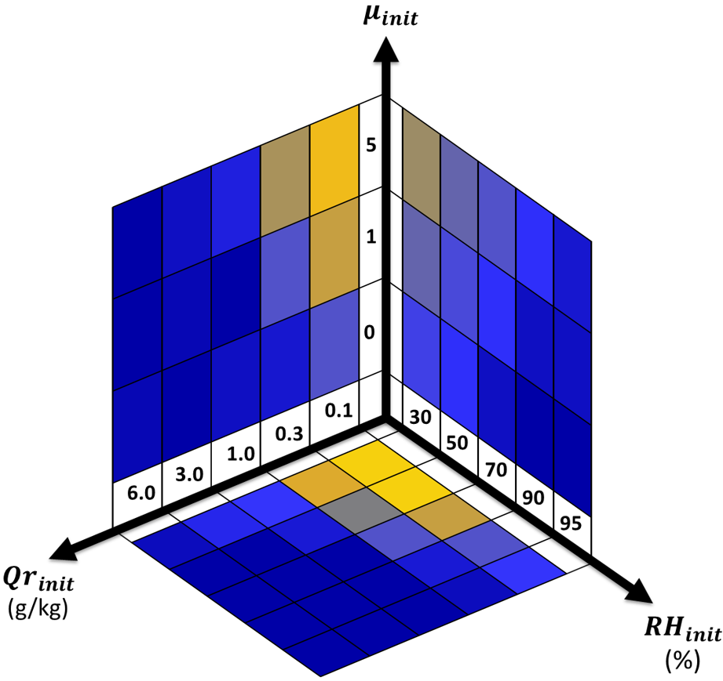
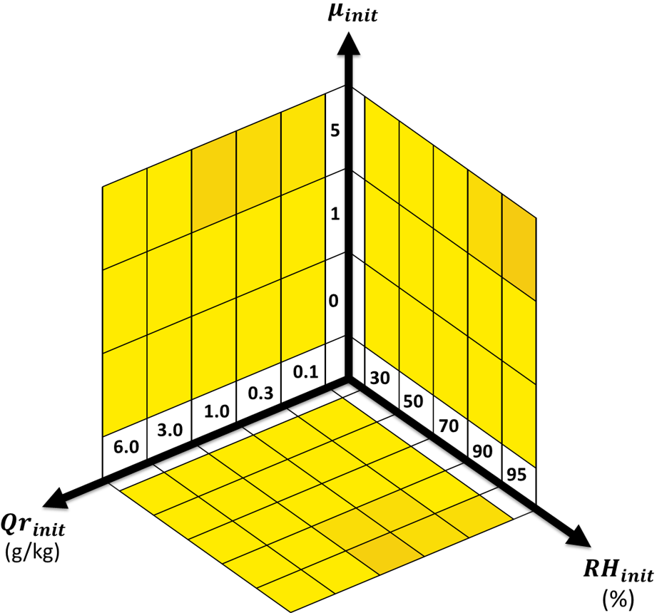
Representation of Rain in Atmospheric Models
Objective
Improve the representation of rain in the Predicted Particle Properties (P3) cloud microphysics scheme
Approach
Predict an additional degree of freedom of raindrop size distribution—i.e., the shape of size distribution—based on physical processes such as evaporation and sedimentation
Develop a new parameterization for raindrop collision and breakup processes considering explicit dependence on raindrop size distribution properties
Impact
A three-moment scheme developed in this study helped simulate rain in a more physically based manner than common two-moment schemes
Under a wide range of atmospheric conditions, the new scheme yielded highly improved simulations of precipitation over the original two-moment scheme
The new scheme can be used to improve accuracy of weather and climate models; the scheme will be implemented in DOE’s Energy Exascale Earth System Model (E3SM)
Initial shape parameter
New
three-moment representation
Initial rain mass
Initial humidity
Original
two-moment representation
Colors indicate the fraction of simulations in which surface rain properties were within ±20% biases from a spectral bin microphysics reference scheme
Under a wide range of atmospheric conditions, a new three-moment scheme showed a considerable improvement: up to 95% of simulations produced rain properties with biases within ±20% of the reference results, whereas only 4% with the original two-moment scheme.
Paukert M, J Fan, PJ Rasch, H Morrison, JA Milbrandt, J Shpund, and A Khain. 2019. “Three-Moment Representation of Rain in a Bulk Microphysics Model.” Journal of Advances in Modeling Earth Systems 11(1):257–277, https://doi.org/10.1029/2018MS001512.
Notes:
http://www.pnnl.gov/science/highlights/highlights.asp?division=749

