Slide 1
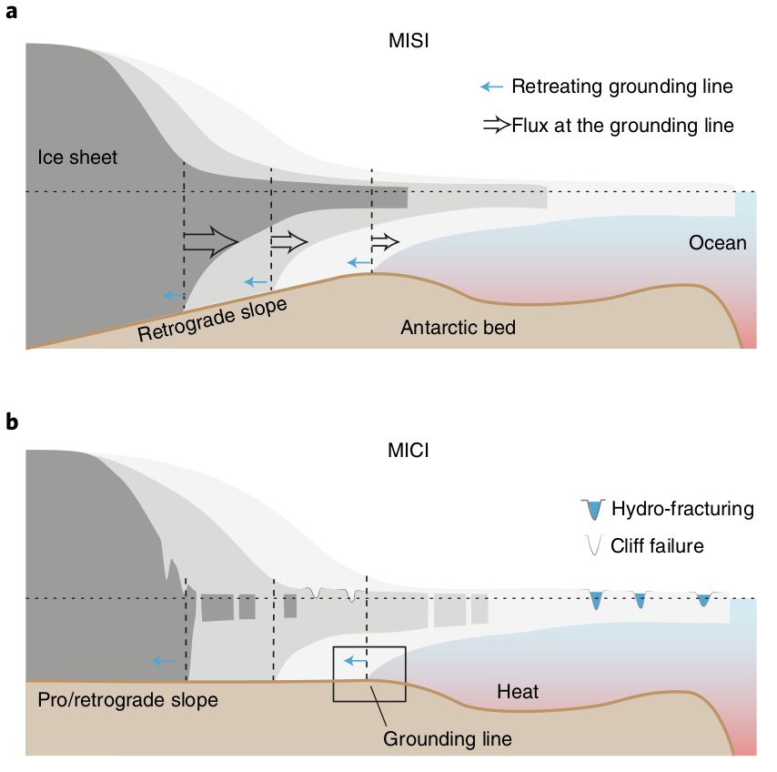

The Greenland and Antarctic ice sheets under 1.5 °C global warming
Objective
Paris Climate Agreement raised scientific questions about
sea-level change with 1.5 °C and with 2 °C of global warming
This review finds that “tipping points” for mass loss from the
Antarctic and Greenland ice sheets may exist between 1.5 and
2 °C
New Science
With 2 °C of warming, Greenland and Antarctic ice sheets will
lose mass throughout the 21st century at rates similar to or
greater than seen today.
Nonlinear feedbacks resulting from changes in the
atmosphere (for Greenland) or the ocean (for Antarctic) could
trigger significantly larger mass losses.
On millennial timescales, both ice sheets have tipping points
at or slightly above the 1.5–2.0 °C threshold
Caveat: large uncertainties remain in future projections of
polar climate and the ice-sheet response
Significance
  It could be possible to significantly mitigate the sea-level
  contributions from the two ice sheets if global warming were
  to remain below 1.5 °C.
Citation - Pattyn, F. et al. The Greenland and Antarctic ice sheets under 1.5 °C global warming. Nature Climate Change (2018). doi:10.1038/s41558-018-0305-8
The Marine Ice Sheet Instability (MISI) and Marine Ice Cliff Instability (MICI) are main drivers for potential, partial collapse of the Antarctic Ice Sheet.

