Slide 1
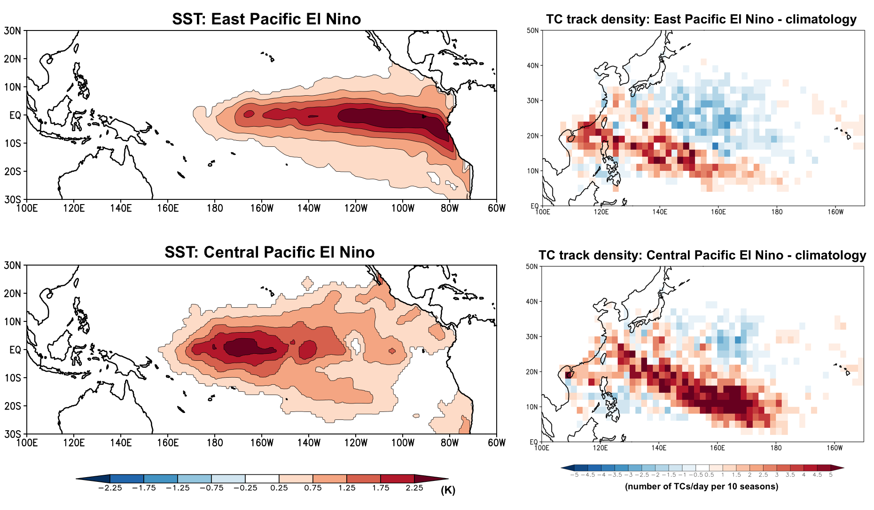

The Influence of ENSO Flavors on Western North Pacific Tropical Cyclone Activity
We discovered that the location of sea-surface temperature (SST) warming during El Niño strongly controls seasonal Western North Pacific tropical cyclone (TC) activity, with central Pacific El Niño driving greater TC activity enhancements than east Pacific El Niño.
This research shows that in order to quantify and reduce uncertainty in future TC projections, Earth System Models must be evaluated and improved for their ability to represent not only the frequency, but also the spatial characteristics of El Niño.
SST forcings applied in the climate model simulations (left) and TC track density response (right).
We performed ensembles of TC-permitting tropical channel model simulations forced with idealized El Niño SST patterns, and applied cluster analysis to TC tracks.
The simulations isolate the influence of the intensity and spatial patterns of El Niño on TCs from other modes of SST variability.
Patricola, C.M., S.J. Camargo, P.J. Klotzbach, R. Saravanan, and P. Chang (2018), The Influence of ENSO Flavors on Western North Pacific Tropical Cyclone Activity. Journal of Climate. DOI: 10.1175/JCLI-D-17-0678.1

