Slide 1
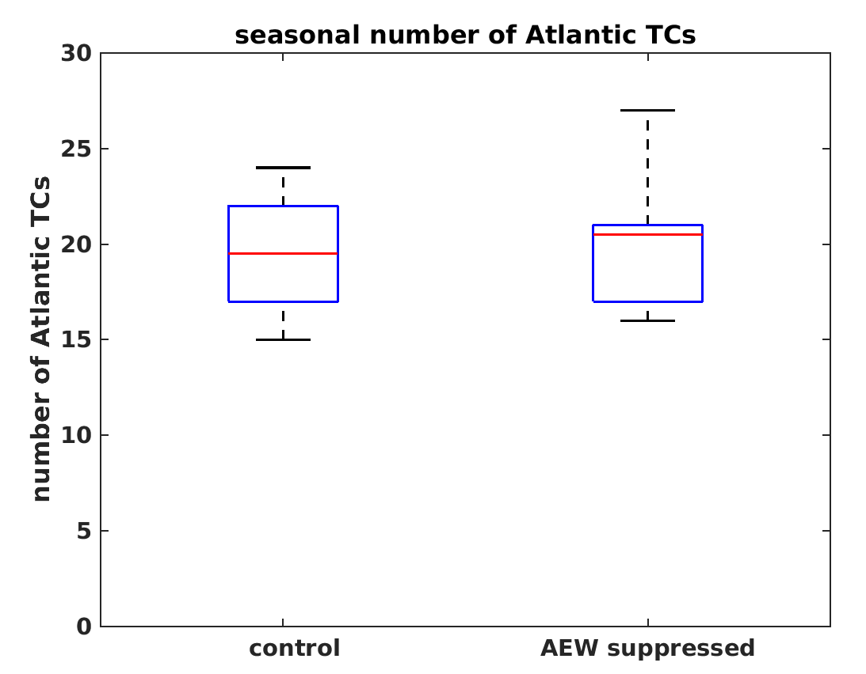

The Response of Atlantic Tropical Cyclones to Suppression of African Easterly Waves
We discovered that Atlantic tropical cyclones (TCs) are not limited by their typical precursor, African easterly waves (AEWs), on seasonal-climate time scales. TCs will generate by other mechanisms in the absence of AEWs.
This research suggests that AEW activity is not a reliable predictor of variability and change in basin-wide Atlantic TC frequency. This work paves the way to investigate how AEWs influence the spatial statistics of TC landfall.
Boxplots of the seasonal number of Atlantic TCs from the 10-member ensemble of the control simulation (forced with observed AEWs) and the AEW suppressed experiment. The differences in the means are statistically insignificant, as shown by the overlap between the two boxplots.
We performed regional climate model experiments in which AEWs were prescribed as observed, or suppressed using a filter, through the lateral boundary condition over the AEW genesis region.
The simulations delineate causality between AEWs and TCs, a problem historically difficult to disentangle using observations owing to covariability of AEWs, TCs, and sea-surface temperature.
Citation: Patricola, C. M., R. Saravanan, and P. Chang (2018), The Response of Atlantic Tropical Cyclones to Suppression of African Easterly Waves. Geophysical Research Letters, 45, DOI: 10.1002/2017GL076081

