Slide 1
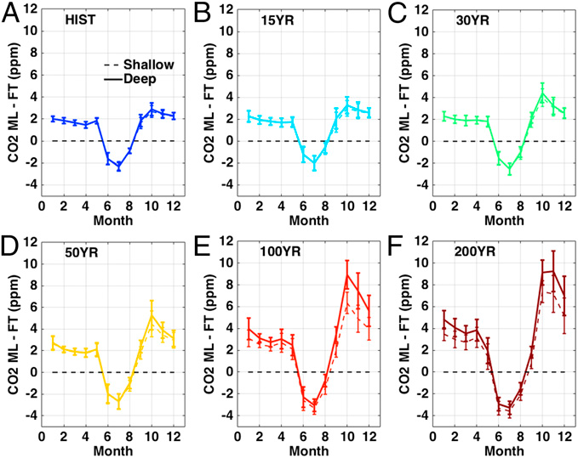
Detecting regional patterns of changing CO2 flux in Alaska
Objective: With rapid changes in climate and seasonal amplitude of CO₂ in the Arctic, it is critical that we detect and quantify underlying processes controlling the changing amplitude of CO₂. We use satellite and airborne observations of atmospheric CO₂ with climatically forced CO₂ flux simulations to assess detectability of Alaskan carbon cycle signals as future warming evolves.
Significance: Dramatic warming in the Arctic has led to increased plant carbon uptake during the growing season; however, microbial soil carbon decomposition during the long cold season may offset summer uptake. We show that current airborne and satellite measurements of atmospheric CO₂ can accurately quantify summer uptake but are insufficient to detect regional changes in cold season emissions. As permafrost thaw and cold season emissions increases, strategies focused on year-round vertical profiles and improved spatial sampling will be needed to track carbon balance changes.
Fig. 1: CO₂ seasonal cycle changes in Alaska for permafrost carbon emission scenarios. CO₂ vertical gradient (surface – free troposphere) for permafrost thaw scenario experiments with pan-Arctic fluxes turned on.
Parazoo, N.C., C. Sweeney, R. Commane, S. Wofsy, C. Koven, D. Lawrence, J. Lindaas, R. Chang, and C.E. Miller, 2016: Detecting patterns of changing carbon flux in Alaska using airborne and satellite observations. PNAS, 113, 7733-7738, doi: 10.1073/pnas.1601085113.

