Slide 1
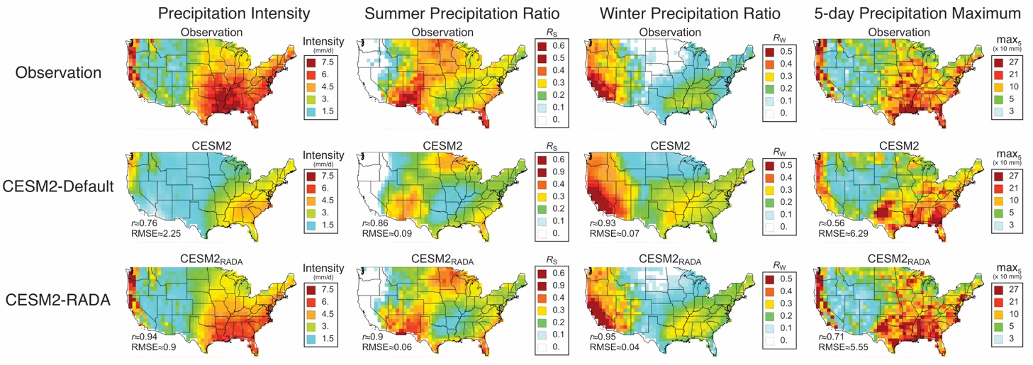
Learning to correct climate projection biases
RGMA
Science Questions
Can we improve climate model projections using observations and deep learning?
By applying the generative adversarial neural networks to CESM2, the predicted decadal mean precipitation intensity, summer and winter precipitation ratio, as well as precipitation extremes are further improved and much closer to observations (both spatial correlation and root mean square error).
Key Accomplishments
A Regularized Adversarial Domain Adaptation (RADA) deep learning methodology is developed to correct climate project biases.
The methodology can identify and correct climate projection biases using unpaired climate simulation and observation data.
Significant improvement is found in projected precipitation estimation for a broad range of spatiotemporal statistics.
Pan, B., Anderson, G. J., Goncalves, A., Lucas, D. D., Bonfils, C. J. W., Lee, J., Y. Tian and H. Ma, 2021: Learning to correct climate projection biases. J. Adv. Model. Earth Syst., 13, e2021MS002509. doi: 10.1029/2021MS002509.

