Slide 1
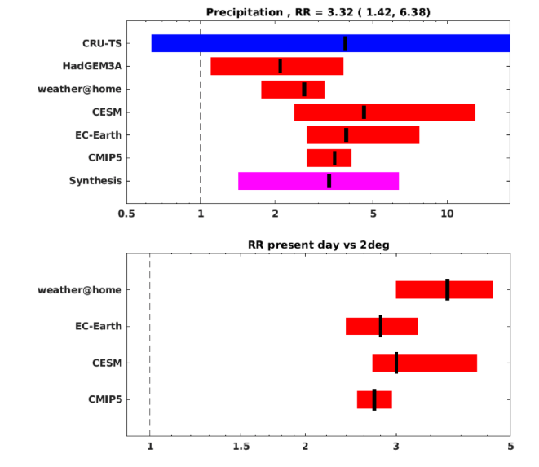


Anthropogenic influence on the drivers of the Western Cape drought 2015-2017
Objective: Using a risk-based multi-model, multi-method approach based on data and climate models, the study seeks to quantify the role of anthropogenic forcing in the occurrence of the extreme drought that affected the western cape province of SouthAfrica from 2015 up to the beginning of this year. Besides characterizing the event and the meteorological drivers leading to it, determining if anthropogenic forcings had a role in increasing its chances is important for considerations of adaptation.
Right: Estimates of the risk ratio between present and pre-industrial condition (top) and between a warmer world and present (bottom) according to the various methods and models employed by the analysis
Research:
-- During this Western Cape drought, 30% to 50% below average rainfall in a relatively large region from 35–31ºS and from 18–21ºE persisted for three years. The meteorological analysis of the event indicate that below average total rainfall in the region was caused by a strong rainfall anomaly in the shoulder seasons (March-May and August-October). The return period of the 2015-2017 3-year annual mean precipitation is approximately 150 years for the observed value of 0.72 mm/day.
-- We use the standard risk-based multi-method approach to extreme event attribution employing station data, gridded observational dataset, as well as the CIMP5 archive, two coupled climate models and two atmosphere-land models to analyze whether and to what extent anthropogenic climate change altered the likelihood of the event.
-- The overall results are robust across methods and models: Combining the observational analysis as well as the models the likelihood of an event like the observed 2015-2017 drought has increased by a factor of 3.3 (1.4 to 6.4). A similar change is expected in a world warmer than the present by one additional degree Celsius.
Impact: While Cape Town’s population continues to grow, the City has been internationally recognized for its water conservation and demand management practices which have stabilized water demand growth to around 2% per annum. However, this hasn’t been sufficient to avoid the impacts of the current drought due, in part, to changing risks. In addition to increasing water efficiency, and implementing water restrictions and tariffs to manage demand, the City explored options for augmenting the water supply (e.g. desalination plants), but these are not anticipated to significantly augment water supply until at least 2019.Given the increasing risk of this type of event, and the vulnerability and exposure context, this study underscores the need for serious consideration for Cape Town’s resilience to current and future drought risk in water management planning.
Otto, F., Wolski, P., Lehner, F., Tebaldi, C., et al., 2018. Anthropogenic influence on the drivers of the Western Cape drought 2015-2017, Environmental Research Letters, DOI: 10.1088/1748-9326/aae9f9

