Slide 1
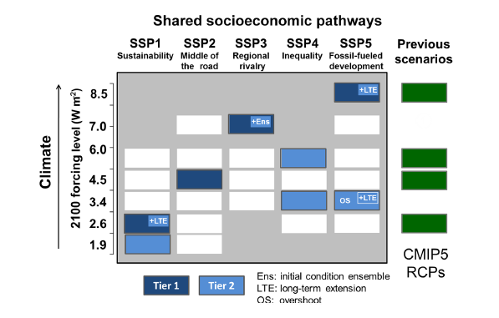
The Scenario Model Intercomparison Project (ScenarioMIP) for CMIP6
Objective: he Scenario Model Intercomparison Project (ScenarioMIP) carries out climate model simulations of alternative plausible futures of emissions and land use. The primary objectives of Scenario-MIP are to:
Facilitate integrated research leading to a better understanding of the physical climate system consequences of future scenarios and their impact on natural and social systems, including adaptation and mitigation considerations.
Provide a basis for addressing targeted science questions about the climate effects of aspects of forcing relevant to scenario-based research.
Provide a basis for various international efforts that target improved methods to quantify projection uncertainties based on multi-model ensembles.
Research: The approved design for the future model experiments to be carried out as part of CMIP6 consists of 8 experiments divided into two tiers according to priority. Figure 1 summarizes the eperiments within the SSP/RCP framework.
The overarching research question addressed by ScenarioMIP experiments
What are the mitigation efforts, climate outcomes, impacts,
and adaptation options that would be associated with
a range of radiative forcing pathways?
Other overarching themes are under the general topic of investigating the Earth system response to external forcing and characterizing the interplay of sources of variability and uncertainty in future projections.
Impact: The CMIP6 simulations according to the ScenarioMIP design will be the primary basis for a wide range of targeted and integrated research activities, the latter able to exploit a consistent set of socio-economic and climate future scenario outcomes, They will also provide the framework that will facilitate assessment activities by the IPCC, within the AR6 cycle and beyond.
O'Neill, B. C., Tebaldi, C., van Vuuren, D. P., Eyring, V., Friedlingstein, P., Hurtt, G., Knutti, R., Kriegler, E., Lamarque, J.-F., Lowe, J., Meehl, G. A., Moss, R., Riahi, K., and Sanderson, B. M.: The Scenario Model Intercomparison Project (ScenarioMIP) for CMIP6, Geosci. Model Dev., 9, 3461-3482, doi:10.5194/gmd-9-3461-2016, 2016.

