Slide 1
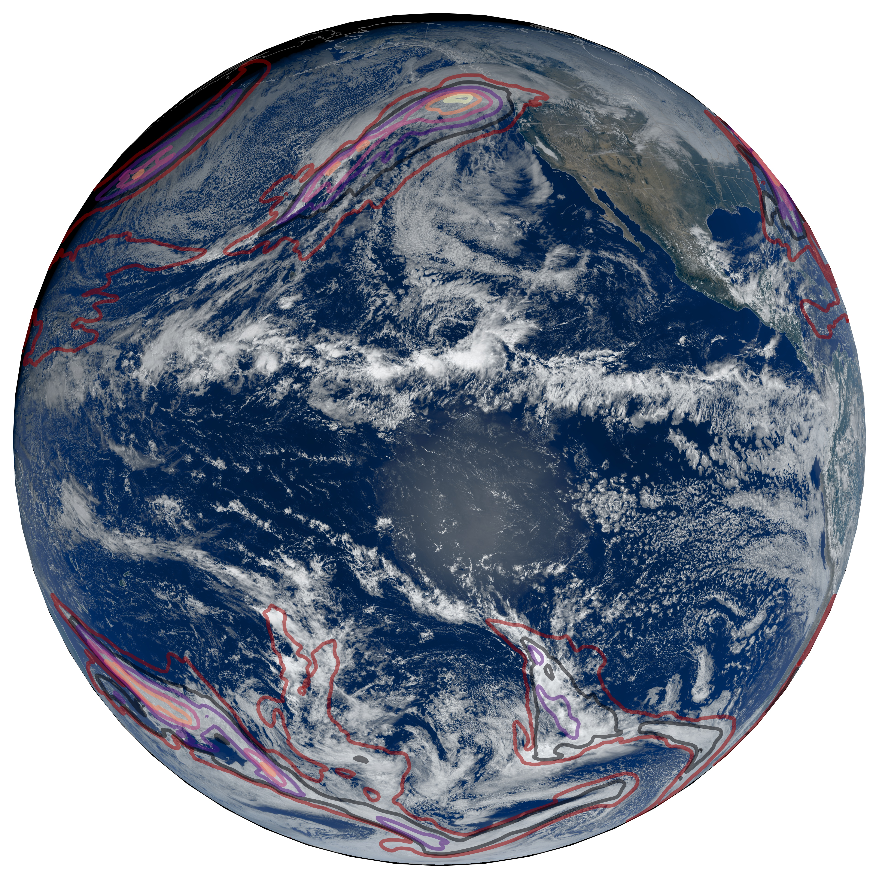
Increases in Future AR Count and Size: Overview of the ARTMIP Tier 2 CMIP5/6 Experiment
The international Atmospheric River Tracking Method Intercomparison Project (ARTMIP) team ran multiple objective atmospheric river (AR) detection tools (ARDTs) on future climate simulations, showing for the first time that (a) most ARDTs detect more ARs and larger ARs as the climate warms, and (b) uncertainty associated with the ARDTs themselves is large.
In addition to revealing a previously-ignored, but large, source of uncertainty—uncertainty associated with the detection of atmospheric rivers—this effort produced a publicly-accessible database of atmospheric river detections in multiple future climate change simulations. This dataset will be central to future efforts to develop a basic understanding of atmospheric rivers and climate change.
Caption: Pseudo color imagery, from the GOES-17 satellite, of the November 13, 2021 atmospheric river that caused major flooding in Vancouver, B.C. The outer red contours outline the boundaries of atmospheric rivers, as identified by an objective ARDT, and the color contours within depict integrated vapor transport at intervals of 250, 500, 750, 1000, and 1250 kg/m/s.
8 ARDTs were applied to 9 climate model simulations
Experiment was coordinated by LBL, Indiana University, and NCAR
Compared simulations of ARs with reanalysis; models perform well
Analyzed changes in AR size, frequency, and count
Compared future projections by model and by ARDT
Showed that most—but not all—ARDTs detect more frequent and larger ARs
Showed that uncertainty in future projections is due to uncertainty with how ARs are objectively detected
O’Brien, T. A., et al. (2021). Increases in Future AR Count and Size: Overview of the ARTMIP Tier 2 CMIP5/6 Experiment. Journal of Geophysical Research Atmospheres, In Press. https://doi.org/10.1029/2021JD036013

