Slide 1
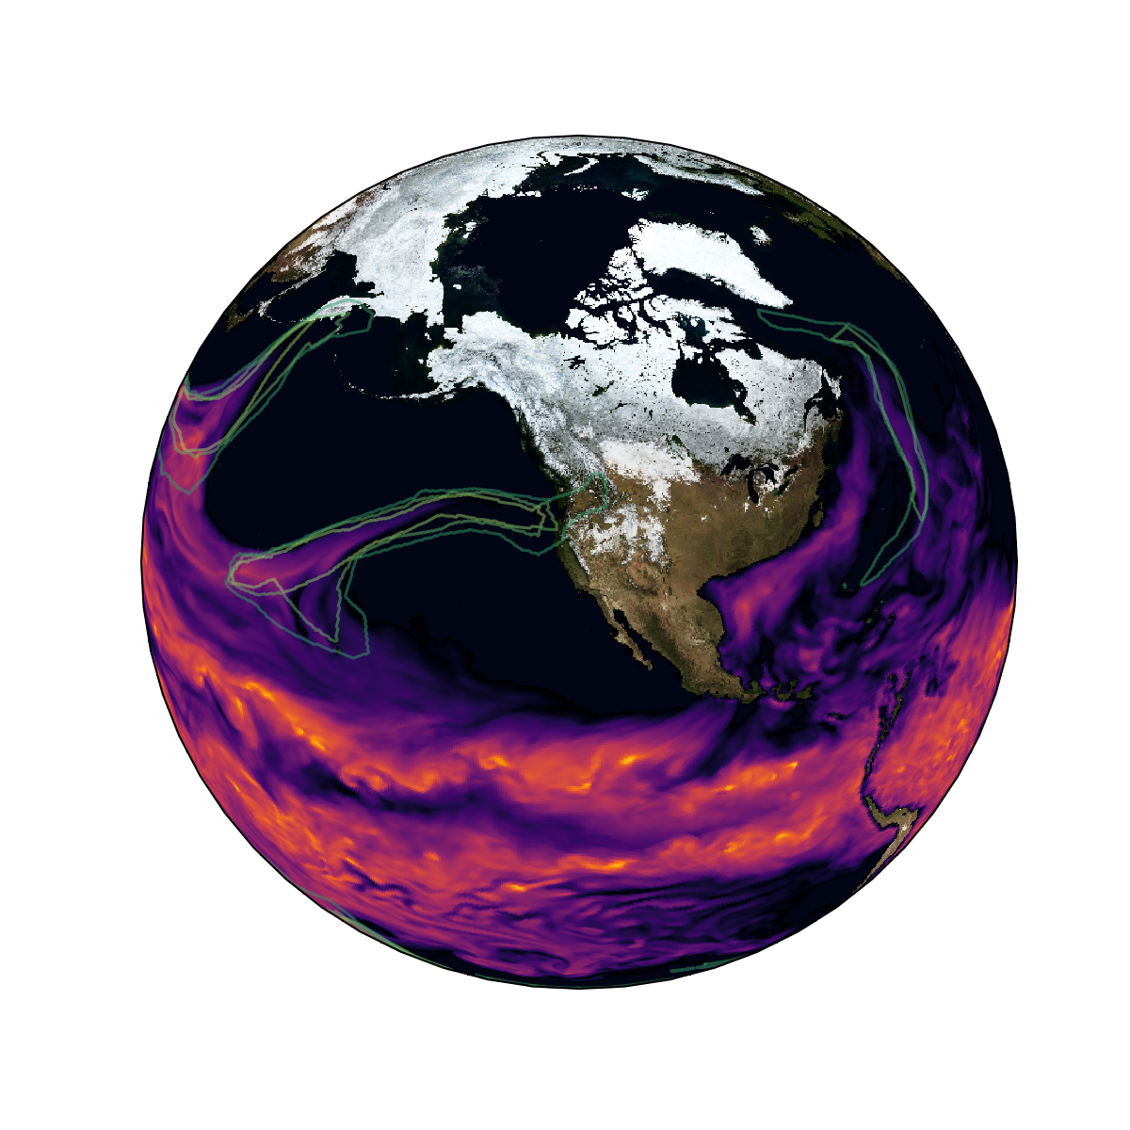

Detection Uncertainty Matters for Understanding Atmospheric Rivers
The Berkeley Lab CASCADE SFA hosted over 30 participants from multiple universities and research institutions for the 3rd Atmospheric River Tracking Method Intercomparison Project (ARTMIP) Workshop.
The workshop summary enumerates emerging directions for atmospheric rivers (AR) research. Participants contributed to the first ever dataset of expert-identified ARs. This will have long-term, positive impacts on the use of machine learning for AR research.
AR identification by multiple experts (green) and precipitable atmospheric water (colors)
Contributed to ClimateNet: a database of expert-labeled ARs
Enumerated emerging AR research directions:
  Understanding drivers of the AR lifecycle
  Categorizing different types of AR
  Categorizing classes of AR detection algorithm
  Leverage machine learning techniques
O’Brien, T.A., Payne, A.E., Shields, C.A., Rutz, J. et al. (2020) “Detection Uncertainty Matters for Understanding Atmospheric Rivers”, Bull. Am. Met. Soc., Accepted. doi:10.31223/osf.io/ftwgm

