Slide 1
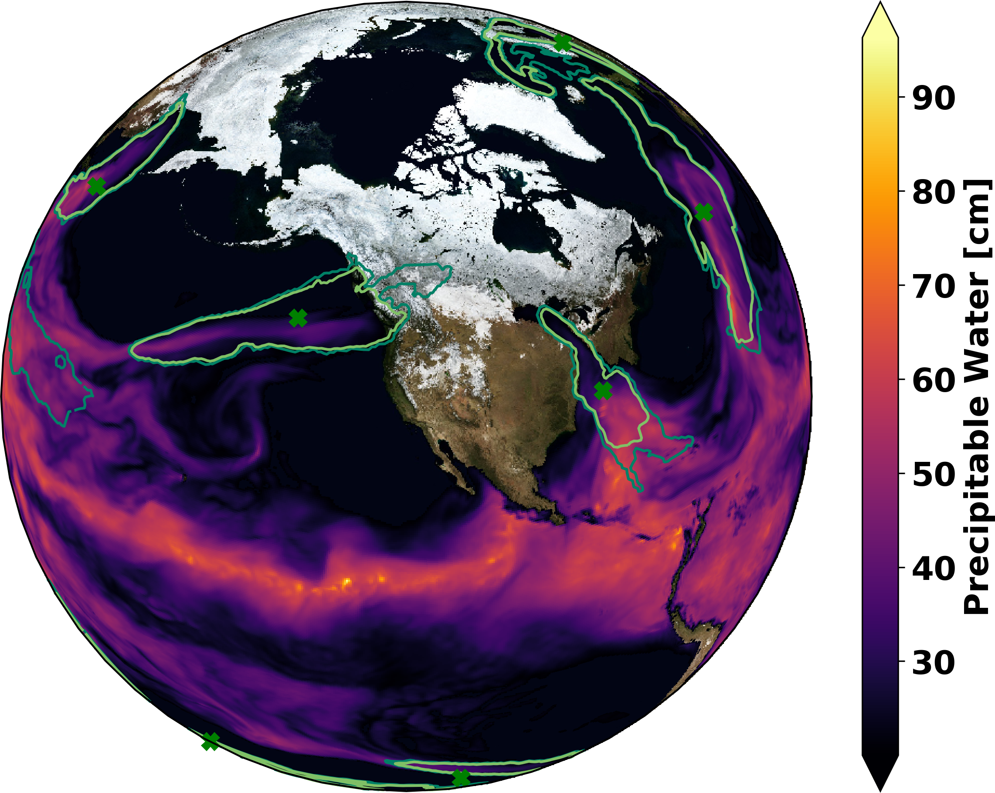

Quantifying Uncertainty in the
Detection of Atmospheric Rivers
The Berkeley Lab CASCADE SFA has created a high-performance-computing tool for quantifying uncertainty in the detection of atmospheric rivers (ARs): the Toolkit for Extreme Climate Analysis Bayesian AR Detector – TECA-BARD v1.0.1
This is the first time that a statistical machine learning technique has been used to train a method (TECA-BARD v1.0.1) to simultaneously (a) emulate the behavior of experts when identifying ARs, and (b) quantify uncertainty associated with the expert’s subjective opinions.
Pseudocoloring of precipitable water with superposed 5%, 50%, and 100% contours of atmospheric river probability. Green x shows ground truth obtained via manual expert identification.
Developed a novel AR detection method
Co-authors manually identified ARs in meteorological maps
Used a Bayesian approach to estimate AR detector parameters, given the expert AR identifications
Showed that the answer to the question “How does El Niño affect the number of ARs?” depends on which expert the method was trained on
Deployed the tool publicly to be used for AR-science applications
O’Brien, T. A., and Co-Authors (2020). Detection of atmospheric rivers with inline uncertainty quantification: TECA-BARD v1.0.1. Geoscientific Model Development, 13(12), 6131–6148. https://doi.org/10.5194/gmd-13-6131-2020

