Slide 1



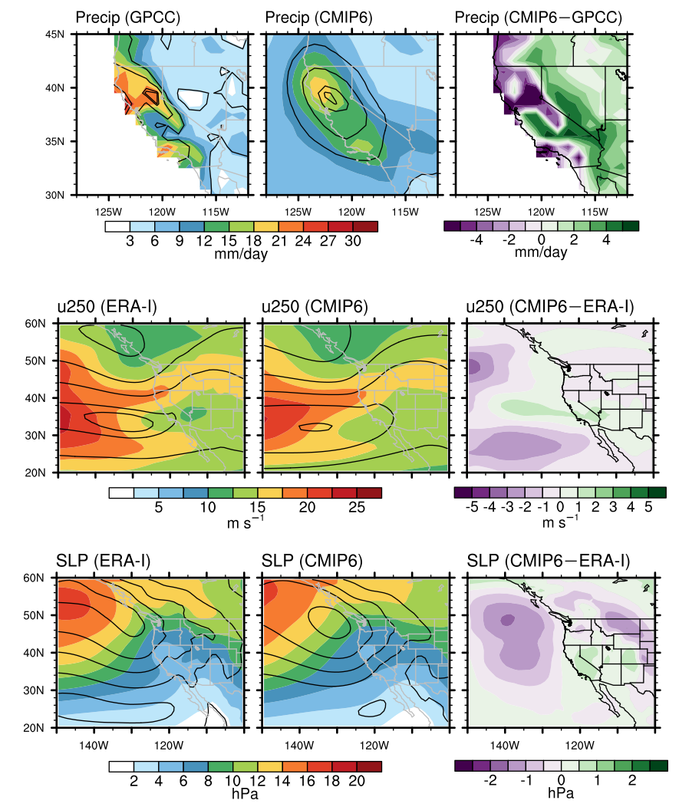
Climate models models underestimate diversity of synoptic conditions associated with extreme precipitation over California
Problem
Global climate models (GCMs) are relied upon to make future projections of regional climate, either directly or via regional climate models, which use the GCMs’ projections as boundary conditions. However, the ability of the GCMs to represent the synoptic variability over individual regions, e.g., California, is not well understood.
Results
- GCMs overestimate California precipitation on days of >95th-percentile statewide-average precipitation. This is related to overestimates of moisture contained within atmospheric rivers.
- On average, CMIP6 models underestimate the variability of precipitation distribution among days of extreme precipitation over California. This is related to underestimates of the variability of the jet stream latitude and of associated surface disturbances.
- Future projections with the same models show precipitation events to be increasingly centered farther poleward, but the GCMs’ shortcomings in the historical climate call these projections into question.
Impact
This study highlights that on average GCMs fail to represent the synoptic variability over a region with highly variable seasonal precipitation such as California. These comparisons to the reanalyses are highly relevant to regional projections, in particular for dynamical and statistical downscaling efforts.
Fig 1:
Reference: Norris, J., A. Hall, D. Chen, C. W. Thackeray, and G. D. Madakumbura 2021: Assessing the Representation of Synoptic Variability Associated With California Extreme Precipitation in CMIP6 Models, J. Geophys. Res. Atmos., 126, e2020JD033938, doi: 10.1029/2020JD033938.
Top row: The standard deviation of precipitation among days of >95th-percentile NDJFMA California precipitation in the historical climate, comparing GPCC and CMIP6 (averaged across all models). Second and third rows: The standard deviation of zonal wind speed at 250 hPa (u250, second row) and sea-level pressure (SLP, bottom row) on the same days, comparing ERA-Interim and CMIP6. In all panels, black contours show the mean of the given variable averaged over the same days.
Notes:
Figure Explanation: Individual models exhibit a wide range of surface warming trends (1979 – 2014) in the central Pacific (horizontal lines in lower left). This translates into a wide range of tropical tropospheric warming in individual model ensembles due to natural climate variability (scatter plot in the upper left and vertical lines in the upper right). Although tropical tropospheric warming does scale with climate sensitivity (ECS, upper right), models with both high and low climate sensitivity have individual realizations that are in accord with observed trends (dashed horizontal horizontal purple lines), which have been suppressed due to diminished central Pacific warming (purple box in upper left) and a La Nina like warming pattern (now shown).
Caption: Tropical mid-tropospheric (TMT) trend (1979 - 2014) versus the central Pacific (Nino 3.4) region SST trend for 482 CMIP6 historical simulations. Models are color-coded based on ECS, with the lowest ECS values in dark blue and highest ECS values in dark red. The range of observational values is denoted by the purple box. Horizontal lines indicate the range of Nino 3.4 trends for individual models with 5 or more ensemble members. The legend also provides the number of ensemble members, n, and the correlation coefficient, r, between the Nino 3.4 and tropical TMT trends for each model. The right side of the figure provides a similar color-coded display of the range of tropical TMT trends plotted against ECS (abscissa). Models with more than one ensemble member are displayed as vertical lines and models with only one ensemble member are denoted with dots.
<number>

