Slide 1
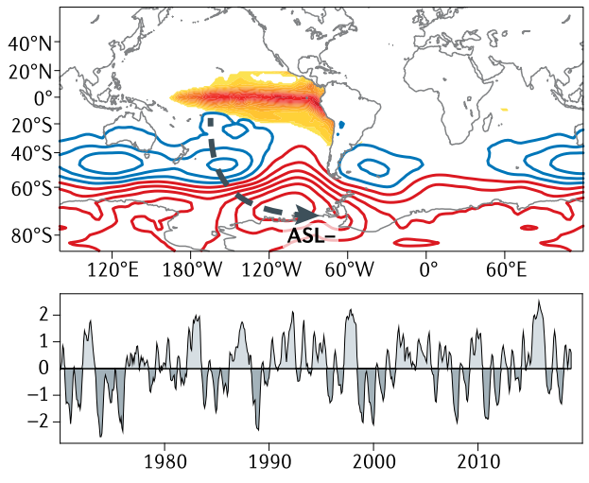
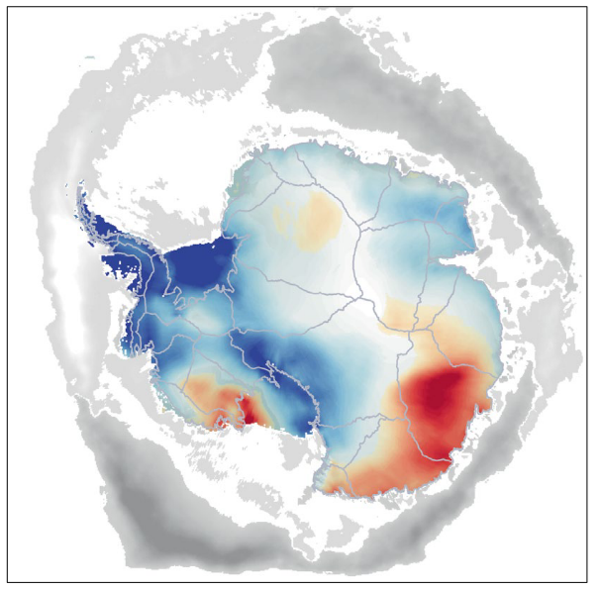
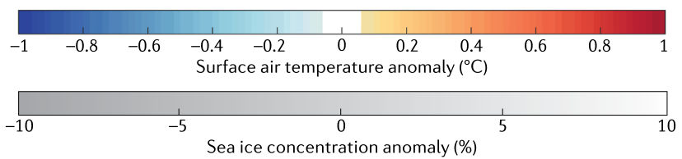
﻿Tropical teleconnection impacts on Antarctic climate changes
Objective
Over the modern satellite era, substantial climatic changes have been observed in the Southern Ocean and the Antarctic
This study aims to summarize tropical teleconnections to the Southern Hemisphere high latitudes arising from the El Niño-Southern Oscillation, the Interdecadal Pacific Oscillation, and the Atlantic Multidecadal Oscillation
Particular focus is given to understanding the physical mechanisms and understanding the long-term climatic impacts
Approach and Results
By synthesizing the results from numerous past studies, we find that tropical-to-polar teleconnections have contributed to the following Antarctic and Southern Ocean changes:
Regional rapid surface warming
Pre-2015 sea ice expansion and its reduction thereafter
changes in ocean heat content
Accelerated thinning of the Antarctic ice sheet
Limited observations and model biases restrict our understanding of the relative importance of tele-connections versus those arising from greenhouse gases, ozone recovery, and internal variability.
Upper-left: 500-hPa geopotential height anomalies (red and blue contours indicating positive and negative anomalies) following positive JJA El Niño–Southern Oscillation event (color shading). Lower-left: Time series of Niño 3.4 index. Right: JJA Antarctic surface air temperature (color) and sea ice concentration (grey scale) anomalies regressed onto the standardized JJA Niño 3.4 index. Tropical sea surface temperature variability promotes stationary Rossby wave propagation to the Southern Hemisphere; atmospheric pressure anomalies (e.g., Amundsen Sea Low, ASL), drive SAT and SIC anomalies.
Impact
Reducing these uncertainties and improving understanding requires:
  pan-Antarctic efforts towards sustained, long-term observations
  more realistic dynamics and parameterizations applied within high-resolution climate models
Reference: Li, X. and 40 others (including S.F. Price). 2021. Tropical teleconnection impacts on Antarctic climate changes. Nature Reviews Earth & Environment, doi.org/10.1038/s43017-021-00204-5

