Slide 1
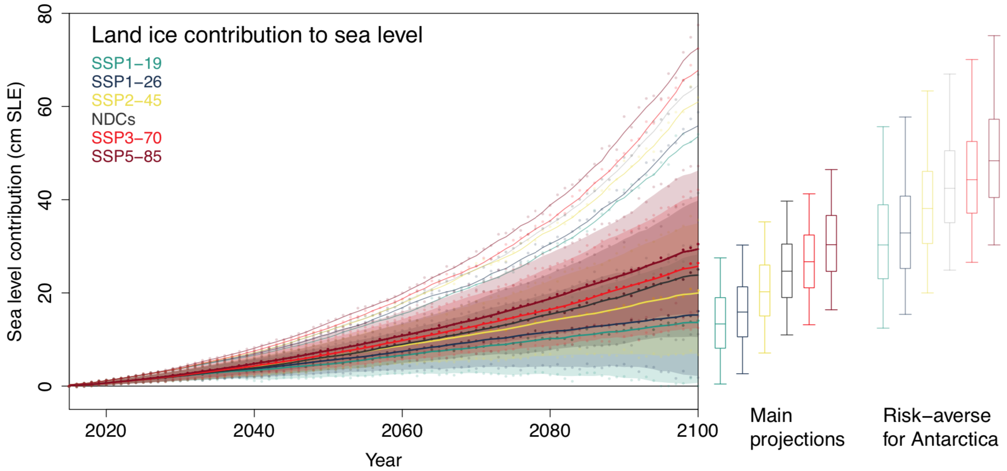
Projected Land Ice Contributions to 21st Century Sea Level Rise
Objective
Estimate the range of future sea-level rise from glaciers and ice sheets (land ice) using the most recent models and emissions scenarios
More fully characterize and represent the range of sea level uncertainty with a particular focus on the uncertainty arising from Antarctica
Research
Apply multiple glacier models, ice sheet models, climate models, and emissions scenarios to characterize the impact of land ice evolution on future sea level rise
Projected 2015-2100 land ice contribution to sea level for a range of emissions scenarios. Solid lines and shaded regions show median and 5-95th percentile estimates, respectively. Pale solid lines denote 95th percentiles for risk-averse projections. Box-and-whiskers indicate 5, 25, 50, 75, 95th percentiles at 2100.
Using these multi-model ensembles and statistical emulation, build probabilistic projections of future sea- level rise from land ice
DOE contributed at multiple levels including selecting appropriate climate models (HiLAT), developing model parameterizations (ProSPect), and conducting high-fidelity, high-resolution ice sheet model simulations using MALI and BISICLES (ProSPect)
Impact
Greatly improved models and methods provide the most comprehensive projections of sea-level rise from land ice to date
Results confirm that Antarctica remains a critical focus for reducing future sea level uncertainty
Limiting global warming to 1.5∘C reduces 21st century land ice contribution to sea-level rise from 25 to 13 cm
Reference: Edwards, T. and 84 others (including 7 DOE), 2021. Projected land ice contributions to 21st century sea level rise. Nature, 591, doi:10.1038/s41586-021-03302-y

