Slide 1
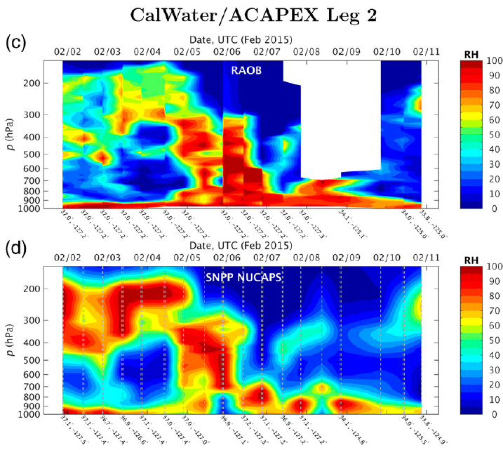
Satellite Sounder Observations of Contrasting Tropospheric Moisture Transport Regimes: Saharan Air Layers, Hadley Cells, and Atmospheric Rivers
Objective
Evaluate the performance of satellite sounder atmospheric vertical moisture profiles under varied and extreme tropospheric conditions using data from intensive field campaigns
Approach
Examine the performance of satellite infrared and microwave sounders in the Atlantic Ocean Saharan air layers (SALs), tropical Hadley cells, and Pacific Ocean atmospheric rivers (ARs), conditions that encompass contrasting moisture profiles driven by different convection and advection transport mechanisms
Compare the satellite retrievals with co-located radiosonde observations obtained from the NOAA Aerosols and Ocean Science Expeditions (AEROSE) in 2013 and the CalWater/Atmospheric Radiation Measurement (ARM) Cloud Aerosol Precipitation Experiment (ACAPEX) in 2015, both on board the NOAA ship Ronald H. Brown
Zonal cross-sectional analyses of relative humidity (RH) for 2015 CalWater/ACAPEX: radiosonde data (upper) and satellite retrievals (bottom).
Impact
Demonstrating the capability of a satellite sounder to monitor the vertical moisture profiles under varied and extreme conditions is a key step in establishing the use of satellite moisture profiles in forecasting and climate studies
Nalli NR, CD Barnet, T Reale, Q Liu, VR Morris, JR Spackman, E Joseph, C Tan, B Sun, F Tilley, LR Leung, and D Wolfe. 2016. “Satellite Sounder Retrievals of Contrasting Moisture Transport Regimes: Saharan Air Layers, Hadley Cells, and Atmospheric Rivers.” Journal of Hydrometeorology 17(12): 2997-3006. DOI: 10.1175/JHM-D-16-0163.1
Notes:
http://www.pnnl.gov/science/highlights/highlights.asp?division=749

