Slide 1
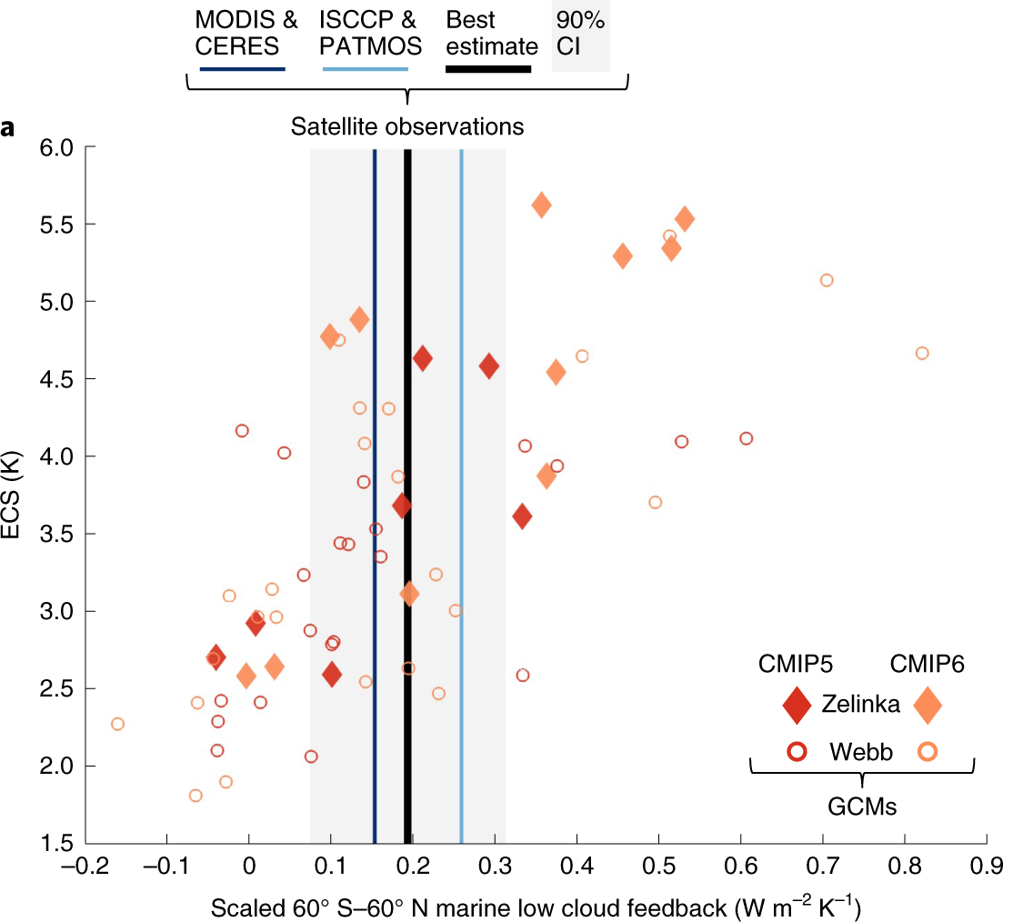
Observational constraints on low cloud feedback reduce uncertainty of climate sensitivity
Scientific Achievement Scientists at Lawrence Livermore National Laboratory and their colleagues analyzed satellite cloud observations to show that low-level clouds over the ocean decrease in response to global warming, leading to further warming by increasing the solar radiation absorbed by the climate system. The team found that this amplifying feedback is more muted compared to previous understanding.
Significance & Impact
The response of low clouds to climate change is a major source of uncertainty in climate sensitivity, the planetary warming resulting from a doubling of atmospheric CO₂. The analysis of observations by the researchers implies that climate sensitivity likely (two-thirds chance) spans 2.4-3.6 °C , a lower and narrower range than in previous estimates.
Effective climate sensitivity (ECS) plotted against the near-global marine low cloud feedback in global climate models (GCMs). Also shown are the best estimate of the feedback constrained by observations and its 90% confidence interval, and the feedback constrained separately by two sets of satellite observations
(MODIS & CERES and ISCCP & PATMOS).
Research Details To predict how clouds over the ocean will evolve under global warming, the researchers used observations to estimate how marine low cloud properties respond to natural variations in large-scale meteorological conditions. The researchers then used global climate model simulations to determine how these meteorological conditions will change as atmospheric CO₂ increases. With this approach, they were able to calculate how the clouds will respond to this modified meteorological environment.
Myers, T. A., R .C. Scott, M. D. Zelinka, S. A. Klein, J. R. Norris, and P. Caldwell, 2021: Observational constraints on low cloud feedback reduce uncertainty of climate sensitivity. Nature Climate Change, doi: https://doi.org/10.1038/s41558-021-01039-0
Notes:
The Science
Scientists at Lawrence Livermore National Laboratory, in collaboration with colleagues at the Scripps Institution of Oceanography and the NASA Langley Research Center, analyzed satellite cloud observations to show that low-level clouds over the ocean decrease in response to global warming, leading to further warming by increasing the solar radiation absorbed by the climate system. Moreover, the team found that this amplifying feedback is more muted compared to previous understanding, due to regional differences in the response of low clouds to warming.
The Impact
The response of low clouds to climate change is a major source of uncertainty in climate sensitivity, the planetary warming resulting from a doubling of atmospheric CO₂. The new analysis of satellite cloud observations by the research team reduces the uncertainty of climate sensitivity. They found that climate sensitivity is likely (two-thirds chance) between 2.4 and 3.6 °C (4.3 and 6.5 °F), a lower and narrower range than in previous estimates.
Summary
To predict how clouds over the ocean will evolve under global warming, the researchers used observations to estimate how marine low cloud properties respond to natural variations in large-scale meteorological conditions. The researchers then used global climate model simulations to determine how these meteorological conditions will change as atmospheric CO₂ increases. With this approach, they were able to calculate how the clouds will respond to this modified meteorological environment. They found positive feedbacks to warming from reductions in the horizontal coverage and reflectivity of eastern ocean stratocumulus and midlatitude low clouds, but that shallow cumulus clouds in the tropics are largely insensitive to greenhouse warming. Their results shed light on some major deficiencies in global climate models. The team found that despite improved midlatitude cloud feedback simulation by several current-generation models, their erroneously positive shallow cumulus feedbacks produce unrealistically high climate sensitivities. However, the researchers also determined that some models simulate erroneously weak low cloud feedbacks and hence unrealistically low climate sensitivities.

