Slide 1
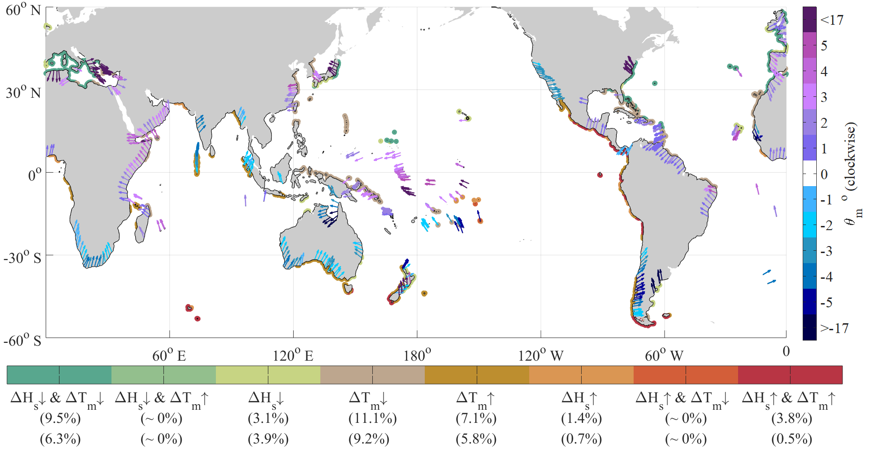
Robustness and uncertainties in global multivariate wind- wave climate projections.
We present findings from the first ‘coherent’, community-based multi-method ensemble of wave-climate projections, derived from ten global studies using a designed pre-established framework. Under a business-as-usual RCP8.5 pathway, we identify robust projected changes in at least one wave variable on ~52% of the world’s coastline with magnitudes of up to ~5-10%. We find that the total variance within the community-ensemble is largely dominated by climate model-driven uncertainty.
World’s coastlines exhibiting projected robust changes in significant wave height (Hs), period (Tm) and directional (θm) characteristics by 2080-2100 under RCP8.5.
Approximately 220 million people currently residing in low-elevation coastal regions are vulnerable to future wave-driven hazards. Anticipated changes to wave climate will result from a combination of meteorological-driven changes in global near-surface ocean winds and morphological-driven changes nearshore, and can potentially aggravate or exceed impacts of projected sea-level rise.
The LBNL contribution to this community paper was data from their high resolution simulations of the CAM5 global atmospheric model performed at the National Energy Research Supercomputer Center. This article was selected as the cover article for Nature Climate Change
J Morim, M Hemer, X Wang, N Cartwright, C Trenham, A Semedo, L Bricheno, P Camus, M Casas-Prat, L Erikson, L Mentaschi, N Mori, T Shimura, B Timmermans, O Aarnes, Ø Breivik, A Behrens, M Dobrynin, M Menendez, J Staneva, M Wehner, J Wolf, B Kamranzad, J Stopa, A Webb, I Young, F Andutta (2019) Robustness and uncertainties in global multivariate wind- wave climate projections. Nature Climate Change. 9, 711–718

