Slide 1
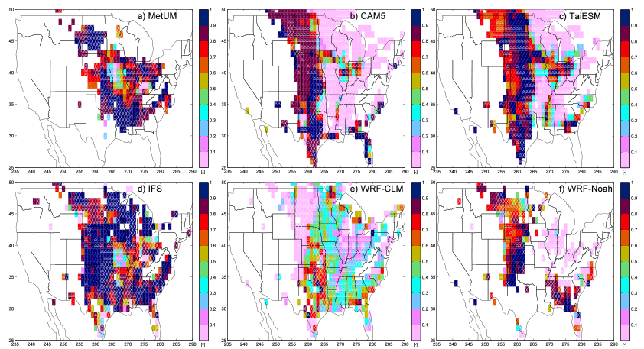
Introduction to CAUSES: Description of near-surface temperature errors in weather and climate models near SGP
RGCM
Science Question
How large are the surface temperature errors over the Midwest in weather and climate models?
How do these errors vary with month, time of day and lead-time into a hind-cast?
Is the model behavior at SGP similar to what is happening across the wider Midwest?
Correlation of diurnal cycle of screen-level temperature error across the Midwest (in terms of local time) with diurnal cycle of the error at SGP.
Key Accomplishments
We show that most participating models have a warm screen-temperature bias in American Midwest.
Bias is several kilometers deep and varies with time of day. Some models most biased at night.
There is spatial coherence in the biases. What we learn from detailed studies at SGP, will help us tackle the biases occurring over much wider regions.
Morcrette, C. J. and coauthors (2018), Introduction to CAUSES: Description of weather and climate models and their near-surface temperature errors in 5-day hindcasts near the Southern Great Plains, J. Geophys. Res. Atmospheres, DOI: 10.1002/2017JD027199

