Slide 1
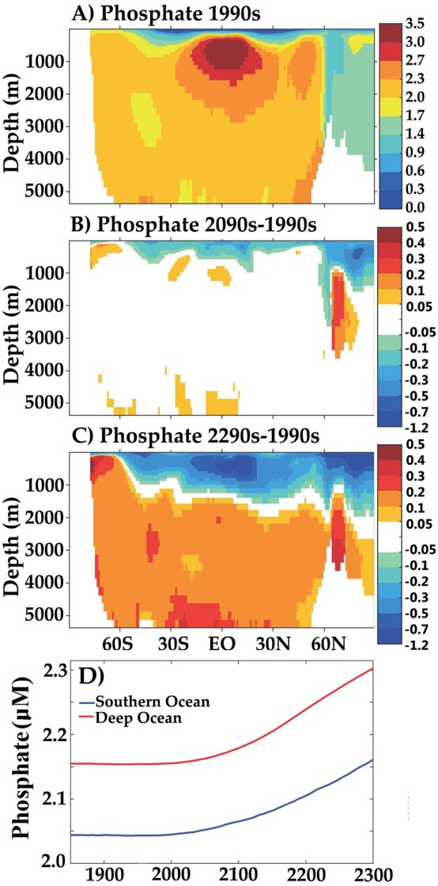
Sustained Warming Drives Declining Marine Biological Productivity
Objective: To study climate change impacts on marine biogeochemistry and productivity over multi-century timescales.
Approach: Analyze Community Earth System Model (CESMv1.0) simulation to year 2300 with RCP8.5/ECP8.5 scenario (atmospheric CO₂ exceeds 1960 ppm).
Results/Impacts: Increasing biological production and export around Antarctica “traps” nutrients. This drives a net transfer of nutrients to the deep ocean, reducing net primary production (NPP) globally. Declining productivity reduces potential global fishery catch by 20%, with declines of nearly 60% in the North Atlantic.
Moore, J. K., W. Fu, F. Primeau, G. L. Britten, K. Lindsay, M. Long, S. C. Doney, N. Mahowald, F. M. Hoffman, J. T. Randerson (2018), Sustained climate warming drives declining marine biological productivity, Science, 359(6380): 1139–1143, doi:10.1126/science.aao6379.
Figure: Antarctic trapping increases nutrient transfer to the deep ocean.

