Slide 1
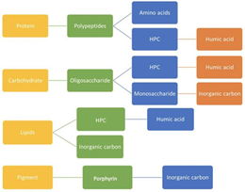
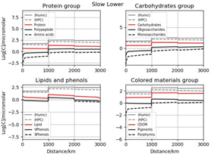
Modeling Functional Organic Chemistry in Arctic Rivers: An Idealized Siberian System
Objective
To examine the biogeochemical evolution of riverine organic macromolecules from highland to Arctic outlets, and estimate their influence on biophysics of the coastal ocean.
Approach
Analysed organic chemical evolution via a Lagrangian kinetic model of an idealized 3000 km river including soil and delta processing with tributaries from Arctic sub-ecological system.
Impact
Along the river chemistry is relatively slow, but tributary mixing dominates. Tributaries carry signature molecules for tundra and taiga sources. Reactive evolution is distinct for various functions, but outlet concentration of some species lie above threshold values biophysical influence.

