Slide 1
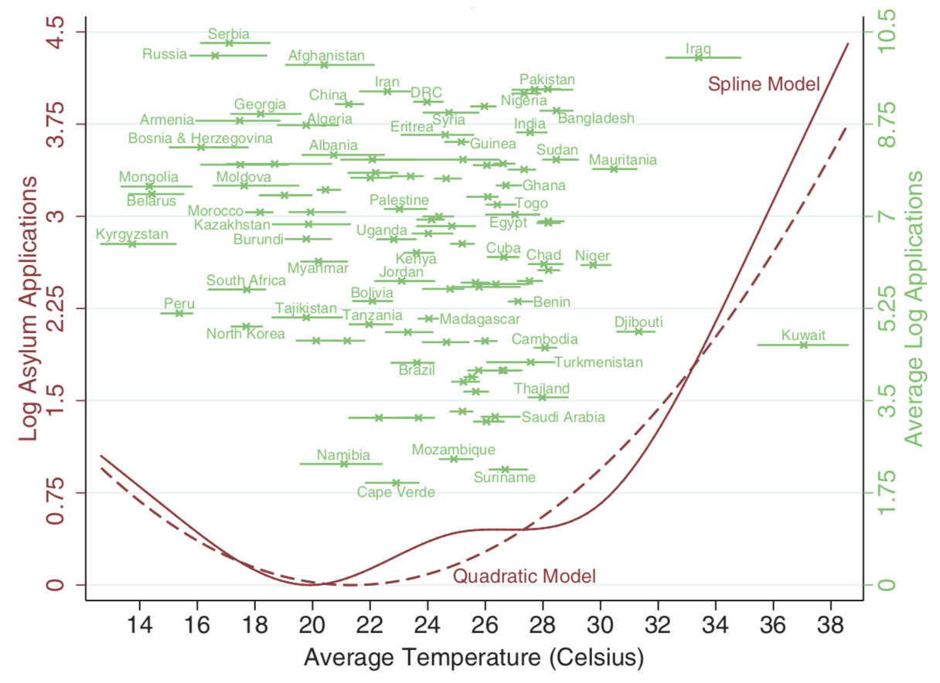
Asylum applications to the European Union respond to weather fluctuations in the origin country
Objective
Does weather in origin country influence how many people apply for asylum in the EU?
Approach
Link anomalies in asylum applications (deviation from average) to weather anomalies (deviation from average weather)
Weather anomalies are random between years and uncorrelated with other factors
Impact
Temperature over the maize growing season and maize growing area have a significant effect on the number of applications
Temperatures around 20C (68F) result in the lowest number of asylum applications
The relationship does not differ by various controls for the origin country (corruption, distance to EU, share in agriculture, etc) and when lags are included.
Rising temperatures would decrease the number of applications from cold countries and increase them from moderate and hot countries
Brown lines show the relationship between temperature in the origin country and asylum applications to the EU. Green lines give the range of observed weather outcomes in 2000-2014 as well as the average number of asylum applications by country.
Missirian, A. and W. Schlenker. 2017. Asylum applications respond to temperature fluctuations. Science, 358(6370): 1610-1614.
DOI: 10.1126/science.aao0432

