Slide 1
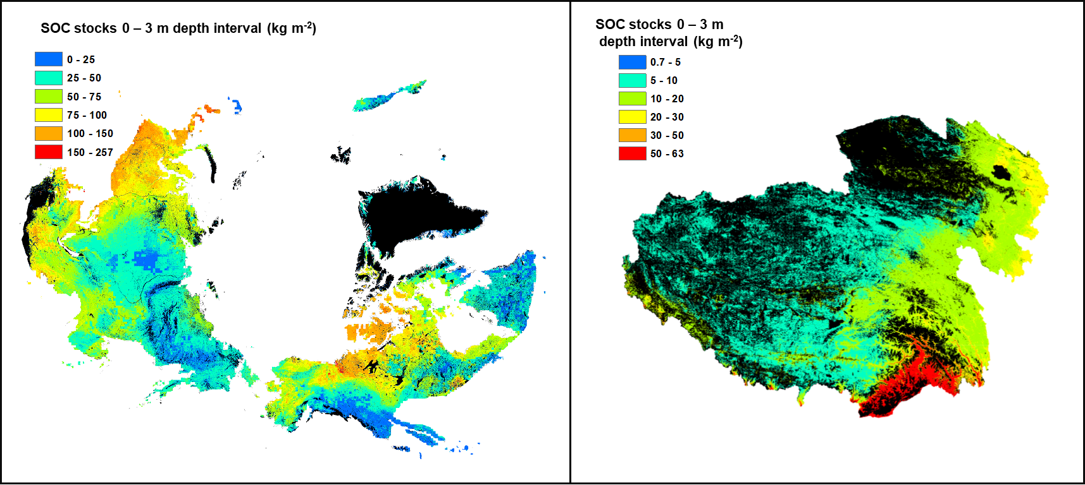
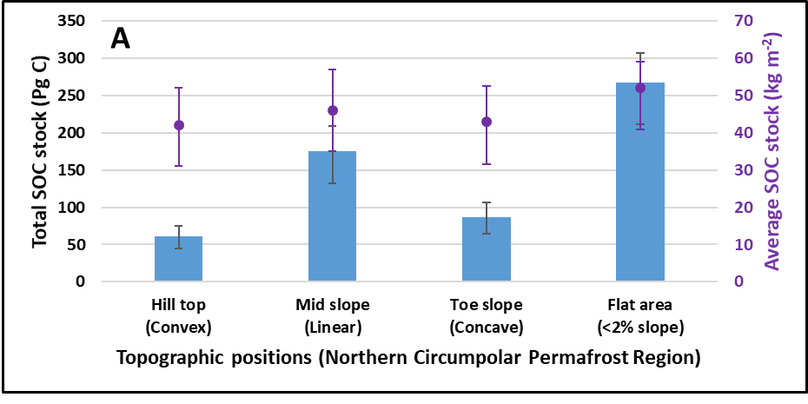
Spatial heterogeneity and environmental controllers of permafrost region soil organic carbon stocks
Objective: To predict the high-resolution spatial distribution of soil organic carbon (SOC) stocks in the Northern hemisphere permafrost region and quantify their relationships with controlling environmental factors.
Approach: Big data of soil and environmental factors were used in geospatial analysis to generation high-resolution estimates of SOC stocks across Northern hemisphere permafrost regions.
Results/Impacts: Large storage of SOC (1014+194−175 Pg C) was predicted across Northern hemisphere permafrost regions. Spatially-explicit estimates of SOC stocks and their relations with environmental factors are crucial for initializing and benchmarking SOC stock representations in land surface models for quantifying the permafrost carbon feedback to climate.
Figure 1: Spatial distribution of SOC stocks in the Northern hemisphere permafrost region.
Mishra, Umakant, G. Hugelius, E. Shelef, Y. Yang, J. Strauss, A. Lupachev, J. W. Harden, J. D. Jastrow, C.-L. Ping, William J. Riley, E. A. G. Schuur, R. Matamala, M. Siewert, L. E. Nave, Charles D. Koven, M. Fuchs, J. Palmtag, P. Kuhry, C. C. Treat, S. Zubrzycki, Forrest M. Hoffman, B. Elberling, P. Camill, A. Veremeeva, and A. Orr (2021), Spatial Heterogeneity and Environmental Predictors of Permafrost Region Soil Organic Carbon Stocks, Sci. Adv., 7(9), eaaz5236, doi:10.1126/sciadv.aaz5236.
Figure 2: Distribution of total and average SOC stocks across different topographic positions.

