Slide 1
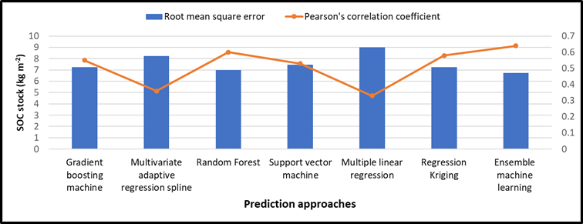
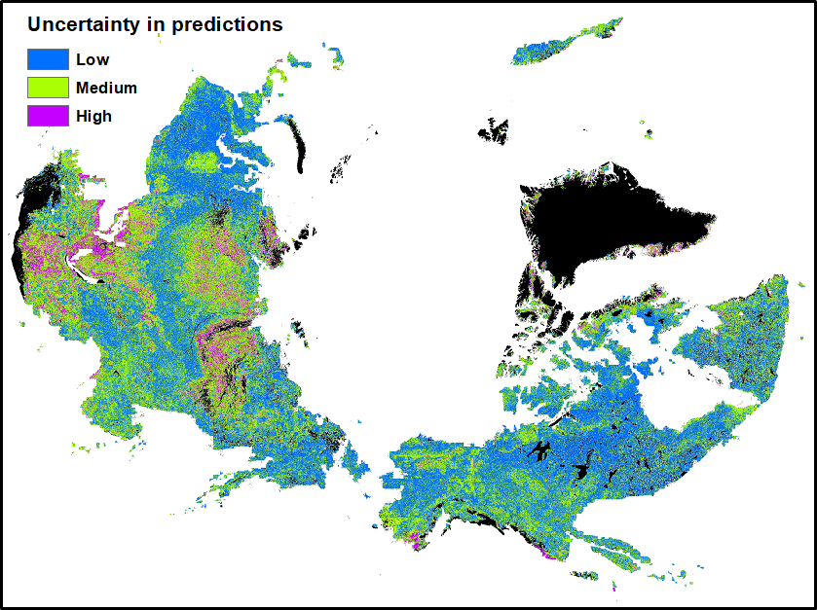
Ensemble machine learning approach produces greater spatial prediction accuracy of soil carbon stocks
Objective: To identify accurate methods for SOC prediction and regions of higher uncertainty in the northern circumpolar permafrost region.
Approach: Combine large dataset of field observations and environmental factors to evaluate prediction accuracy of machine learning (ML) techniques in comparison to a widely used approach, regression kriging.
Results/Impacts: The ensemble ML approach provides greater spatial details and higher prediction accuracy in comparison to regression kriging and other individual ML approaches. Areas with high uncertainty in predicted SOC stocks were found in small patches in Southern Alaska and in larger areas of the Southern and Western Russian permafrost region.
Figure 1: Prediction accuracy obtained from different machine learning approaches.
Mishra, Umakant, Sagar Gautam, William J. Riley, and Forrest M. Hoffman (2020), Ensemble Machine Learning Approach Improves Predicted Spatial Variation of Surface Soil Organic Carbon Stocks in Data-Limited Northern Circumpolar Region, Front. Big Data, 3:40, doi:10.3389/fdata.2020.528441.
Figure 2: Uncertainties in surface SOC stocks in the northern circumpolar permafrost region.

