Slide 1
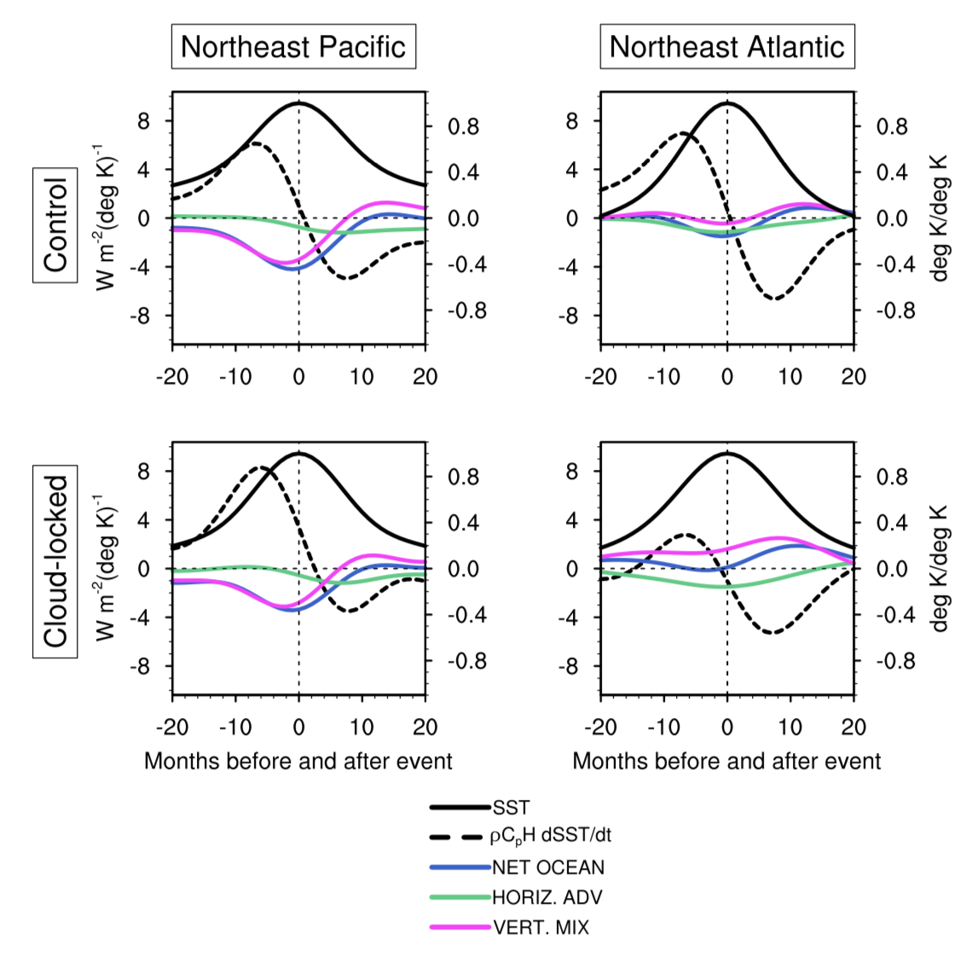
Contributions of atmospheric and oceanic feedbacks to subtropical northeastern sea surface temperature variability
Eleanor Middlemas, Amy Clement, and Brian Medeiros
Climate Dynamics, https://doi.org/10.1007/s00382-019-04964-1
Objective
Understand the roles of cloud feedbacks and ocean dynamics in subtropical SST variability.
Approach
Use CESM1 in four configurations:
                Control: active ocean, active cloud feedbacks
                Slab: thermodynamic ocean, active cloud feedbacks
                Locked: active ocean, disabled cloud feedbacks
                Slab-Locked: thermodynamic ocean, disabled cloud feedbacks
Ocean mixed layer budget is used to decompose the differences.
Impact
Cloud feedbacks act to enhance SST variability.
Ocean dynamics act to reduce the clouds’ impact.
The reduction is much greater in the Atlantic.
In the Atlantic, ocean dynamics can drive SST anomalies, while in the Pacific ocean dynamics always acts as a damping.
Lead-lag regressions of anomalous oceanic mixed layer heat budget terms on SST anomalies within regions of strong positive cloud feedback in the subtropical Northeast Pacific (left) and Atlantic (right). The “Control” has cloud radiative feedbacks active, and “cloud-locked” has cloud feedbacks disabled. These are all fully-coupled, so ocean dynamics are active. Note the different ocean behavior (blue curves) between the regions.

