Slide 1
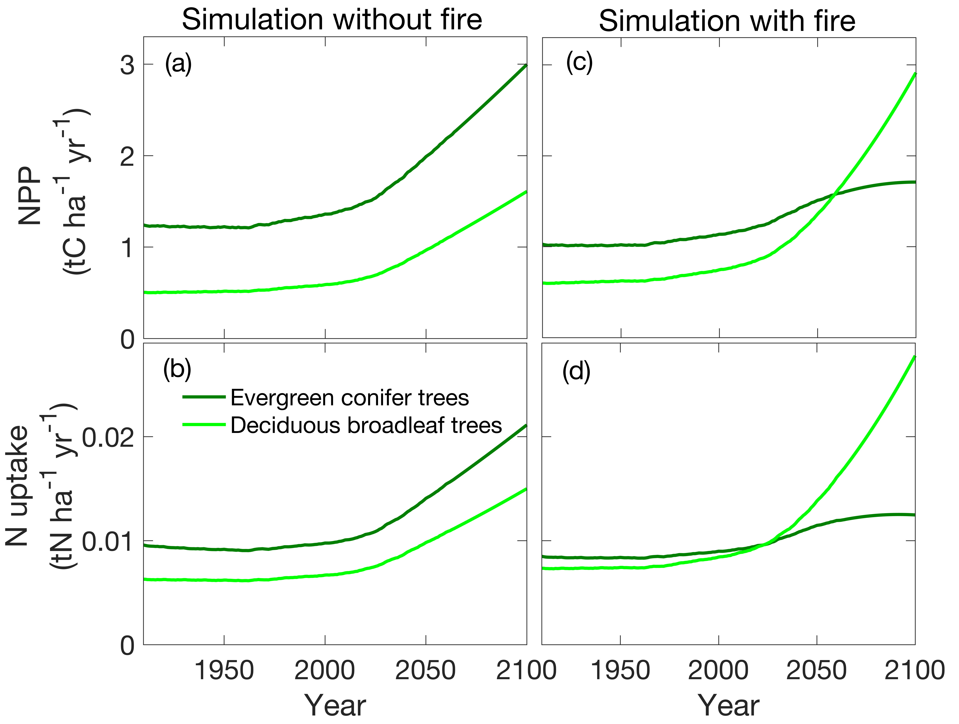
Expansion of high-latitude deciduous plants driven by interactions between climate warming and fire
Scientific Achievement
We modeled, consistent with changes during the Holocene, that changes in 21st century climate and fire are likely to alter vegetation composition across Alaska.
The relative dominance of deciduous plants nearly doubles, accounting for 58% of Alaska ecosystem net primary productivity by 2100.
Deciduous trees will dominate northern boreal forest ecosystems.
Deciduous and evergreen shrubs will increase in much of the Arctic tundra.
Expansion of deciduous vegetation will affect the carbon cycle, surface energy fluxes, and ecosystem function, thereby affecting multiple feedbacks with the climate system.
Significance and Impact
Figure. Deciduous plant functional types become dominant around 2058 because of interactions between increased soil temperatures and fire.
Mekonnen, Z.A., Riley, W.J., Randerson, J.T., Grant, R.F, and Rogers, B.M. (2019): Interactions between climate warming and fire will drive expansion of high-latitude deciduous vegetation, in press Nature Plants.
Research Details
We applied a well-tested mechanistic model, ecosys, and examined how plant functional types across Alaska respond to projected 21st century changes in climate and fire regime.

