Slide 1
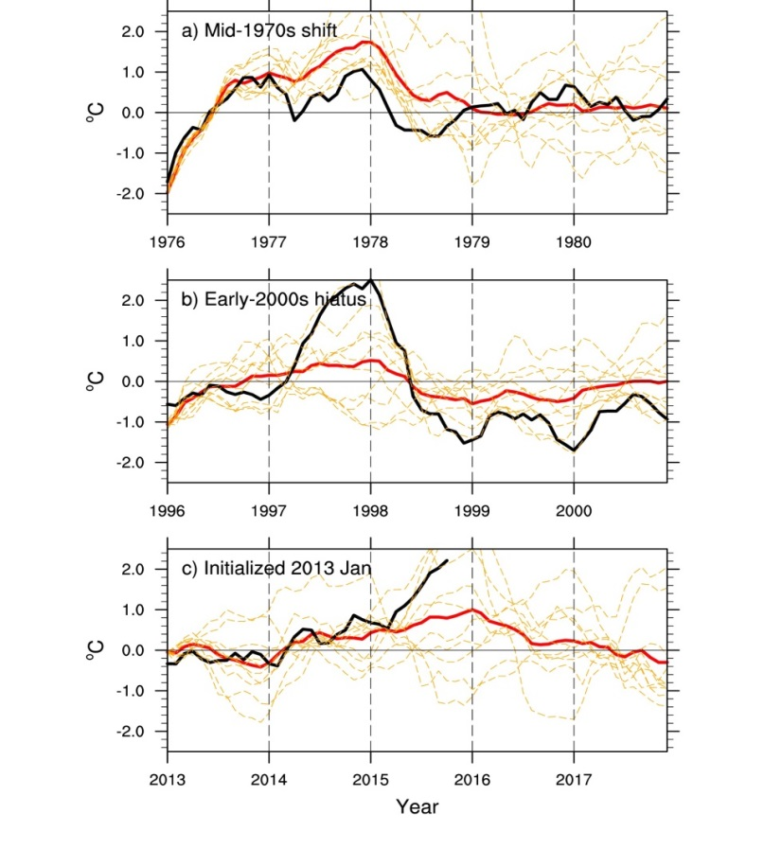
Climate model predicts El Niño as trigger for IPO transition
Objective
The phase of the Interdecadal Pacific Oscillation (IPO), a dominant mode of decadal timescale variability in the tropical Pacific, has been shown to be connected to the early-2000s slowdown in the rate of global surface temperature increase. Can we predict the next phase change of the IPO, with a resumption of larger rates of global warming?
Monthly mean time series of initialized predictions for equatorial eastern Pacific SST anomalies (5°S-5°N, 120°W-170°W), observations (black lines); individual model ensemble members (dashed lines); ensemble average (solid red lines); a) prediction for the mid-1970s shift to positive IPO and accelerated global warming, initialized January 1, 1976; b) prediction for early-2000s hiatus to negative IPO and reduced global warming, initialized January 1, 1996; c) prediction initialized January 1, 2013, for positive IPO, and resumption of larger rates of global warming.
Approach
Analyze initialized hindcasts of CCSM4 to show that past IPO transitions have been associated with a buildup of off-equatorial ocean heat content in the western Pacific
Analyze those hindcasts to show that ENSO events have acted as a trigger for IPO transitions
Impact
The year 3-7 average prediction (2015-2020) from the 2013 initial state shows a small El Niño in 2014, and a larger El Niño in 2015 with a transition to the positive phase of the IPO from the previous negative phase, and a resumption of larger rates of global warming consistent with a positive IPO phase
Meehl, G.A., A. Hu, and H. Teng, 2016: Initialized decadal prediction for transition to positive phase of the Interdecadal Pacific Oscillation and resumption of larger rates of global warming. Nature Comms., under review.

