Slide 1
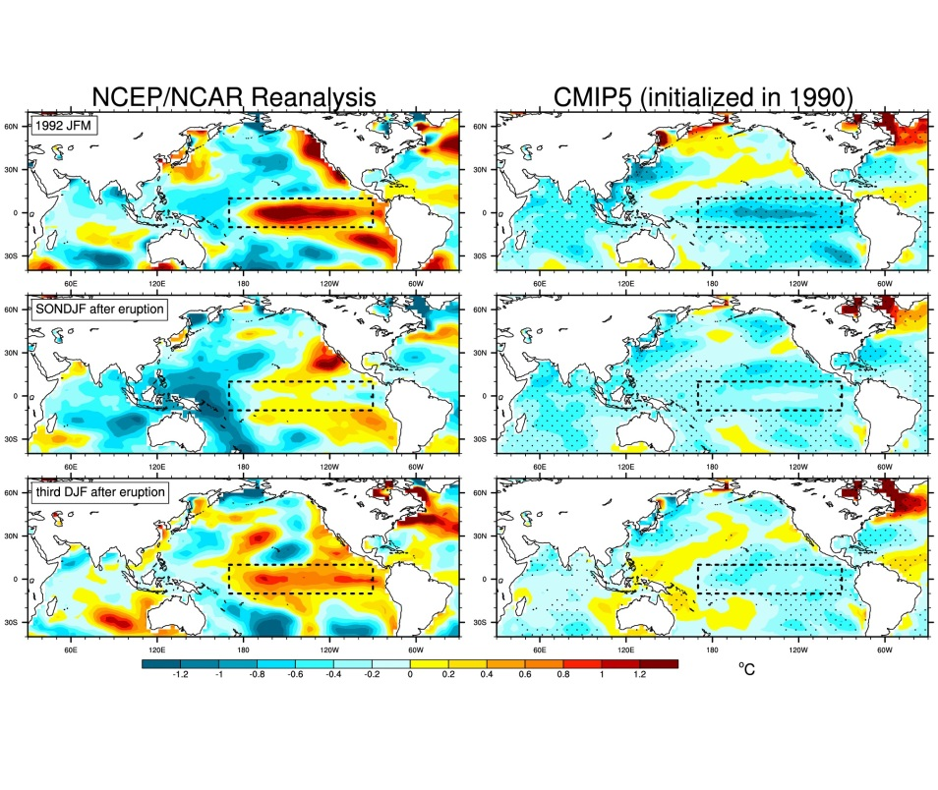
The effects of volcanic eruptions on climate prediction skill
Objective
It has been thought that a large volcanic eruption would introduce artificial skill in a retrospective decadal climate prediction and simplify the problem. But the Mt.Pinatubo eruption in 1991 actually reduced skill for predictions of tropical Pacific sea surface temperatures (SSTs), while other large eruptions did not. This leads to the question of what are the effects of volcanic eruptions on decadal climate prediction skill in the Pacific?
Left column shows observations for seasons following the 1991 Pinatubo eruption, right column shows CMIP5 multi-model average predictions initialized prior to the eruption in 1990 for those same seasons, showing why the initialized predictions for the Pinatubo-affected years have low skill in the Pacific
Approach
Analyze initialized hindcasts of the CMIP5 multi-model ensemble for predicted 3-7 year averages after the major volcanic eruptions from 1960-2000, and compare to observations
Analyze the CESM1 large ensemble to diagnose a single model’s response to those same large volcanic eruptions
Impact
The post-eruption sequence of Pacific SSTs after the Pinatubo eruption did not happen to follow the multi-model multi-ensemble sequence, while the internal variability in the observations after El Chichon and Agung was closer to the forced response in the models. Thus a volcanic eruption actually complicates the Pacific decadal climate prediction problem.
Meehl, G.A., H. Teng, N. Maher, and M.H. England, 2015: Effects of the Mt. Pinatubo eruption on decadal climate prediction skill. Geophys. Res. Lett., doi:10.1002/2015GL066608.

