Slide 1
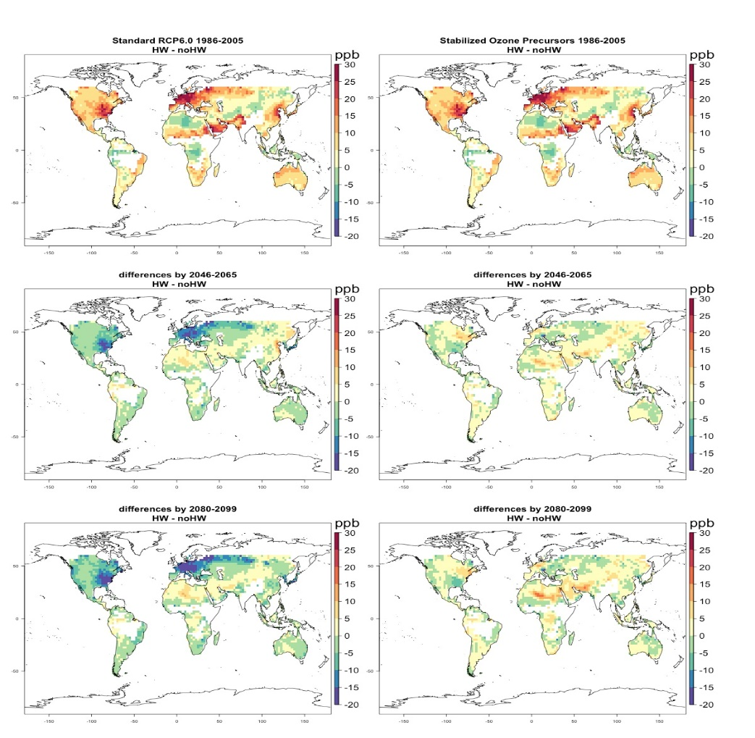


Future heat waves and extreme surface ozone events
Objective: Understand how more intense heat waves in the future could affect severe surface ozone events
Research:
--Analyze a global Earth system model that simulates the observed relationship between heat waves and elevated surface ozone levels with associated severe health impacts
--The model is driven by emissions of greenhouse gases and ozone precursors from a medium-high emission scenario (RCP6.0) compared to an experiment with ozone precursor emissions fixed at 2005 levels
Impact: Ozone concentrations during future more intense heat waves decrease in areas where ozone precursors are prescribed to decrease in RCP6.0 (e.g. most of North America and Europe), and ozone concentrations during heat waves increase in areas where ozone precursors either increase or have little change (e.g. central Asia, the Mideast, northern Africa). With stabilized ozone precursors, surface ozone concentrations increase during future heat waves compared to non-heat wave days in most regions except where there is ozone suppression that is likely associated with changes in isoprene emissions at high temperatures from forests
Top panels: Orange and red areas denote higher ozone during present-day heat waves in the model as observed; Panels at lower left: green and blue colors show decreases of ozone during future more intense heat waves in middle and late century due to the prescribed decreases in ozone precursors in RCP6.0, yellow denotes higher ozone in heat waves where there are prescribed increases of ozone precursors; Panels at lower right: Orange and yellow areas are where ozone increases in future more intense heat waves with stabilized ozone precursors, green areas are where ozone decreases in future intense heat waves mainly due to ozone suppression likely related to changes in isoprene emissions from forests
Meehl, G.A., C. Tebaldi, S. Tilmes, J.-F. Lamarque, S. Bates, A. Pendergrass, and D. Lombardozzi, 2018: Future heat waves and surface ozone. Env. Res. Lett., http://iopscience.iop.org/article/10.1088/1748-9326/aabcdc.

