Slide 1
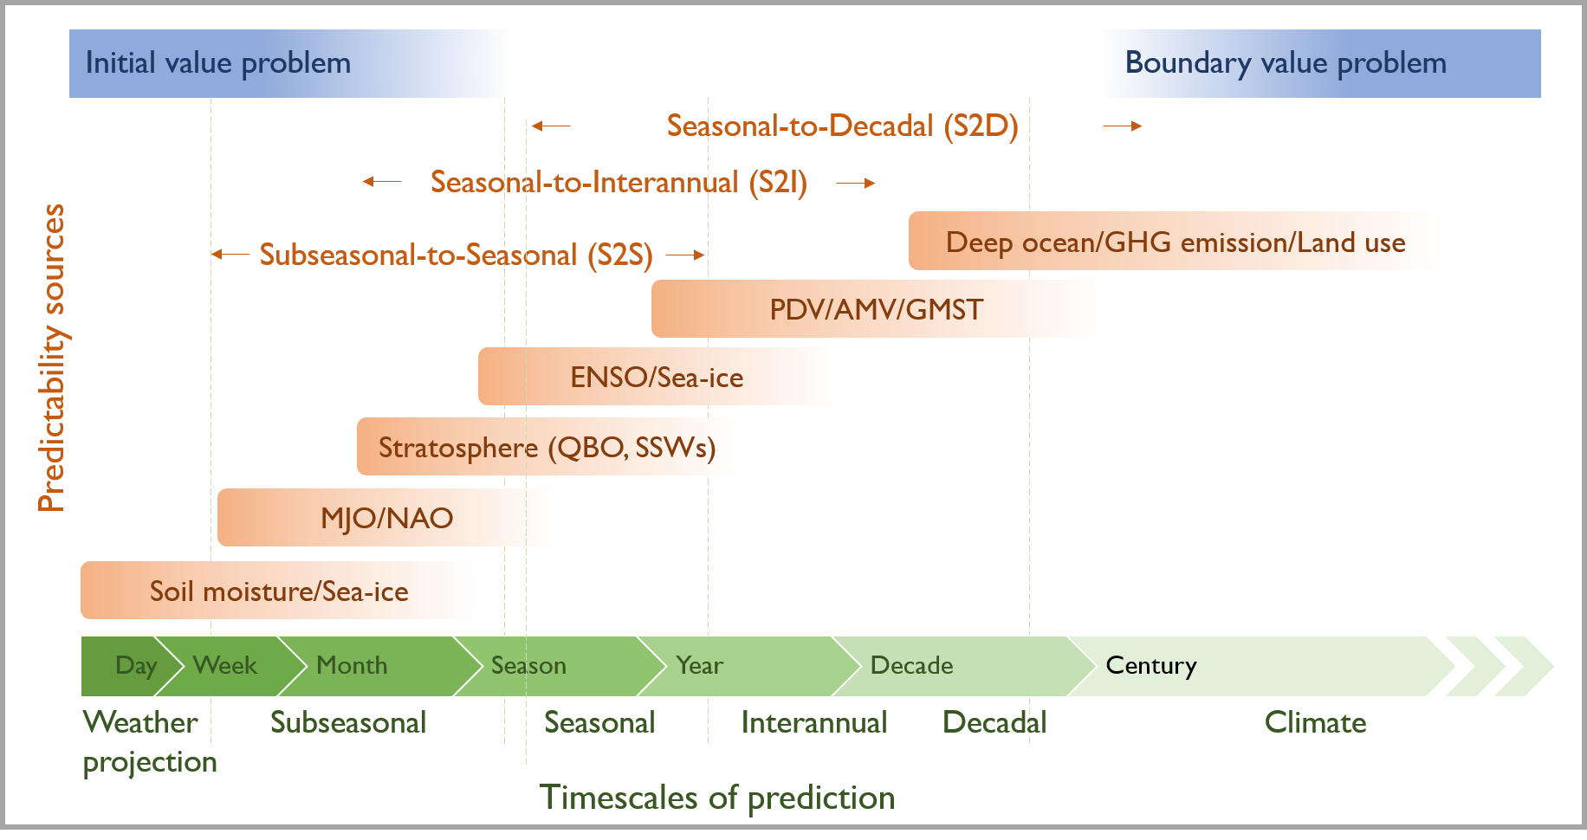
Initialized Earth System prediction from subseasonal to decadal timescales
Meehl, G.A., J.H. Richter, et al., 2021: Initialized Earth system prediction from subseasonal to decadal timescales, Nature Reviews Earth and Environment, https://doi.org/10.1038/s43017-021-00155- x. (DOE-funded authors in bold face)
OBJECTIVE
Initialized Earth System predictions are made by starting a numerical prediction model in a state as consistent as possible to observations and running it forward in time for up to ten years. Skillful predictions at time slices from subseasonal to seasonal (S2S), seasonal to interannual (S2I) and seasonal to decadal (S2D) offer information useful for various stakeholders, from agriculture to water resource management to human and infrastructure safety
APPROACH
Examine the processes influencing predictability, and discuss estimates of skill across S2S, S2I and S2D timescales. Review the literature describing various aspects of initialized climate predictions, and assess the current state of knowledge and associated relevant research challenges that need to be addressed.
Timescales and sources of predictability for S2S, S2I, and S2D. Lighter green shading indicates larger uncertainty. MJO: Madden-Julian Oscillation; NAO: North Atlantic Oscillation; QBO: Quasi-Biennial Oscillation; SSWs: Sudden Stratospheric Warmings; ENSO: El Niño-Southern Oscillation; PDV: Pacific Decadal Variability; AMV: Atlantic Multi-decadal variability; GMST: Global Mean Surface Temperature; GHG:
IMPACT
There are encouraging signs that skillful predictions can be made: at S2S timescales, there has been some skill in predicting the Madden-Julian Oscillation and North Atlantic Oscillation; at S2I in predicting the El Niño-Southern Oscillation; and at S2D, in predicting variability in North Atlantic sea surface temperatures. However, challenges remain, and future work must prioritize reducing model error, more effectively communicating forecasts to users, and increasing process and mechanistic understanding that could increase predictive skill and, in turn, confidence.

