Slide 1
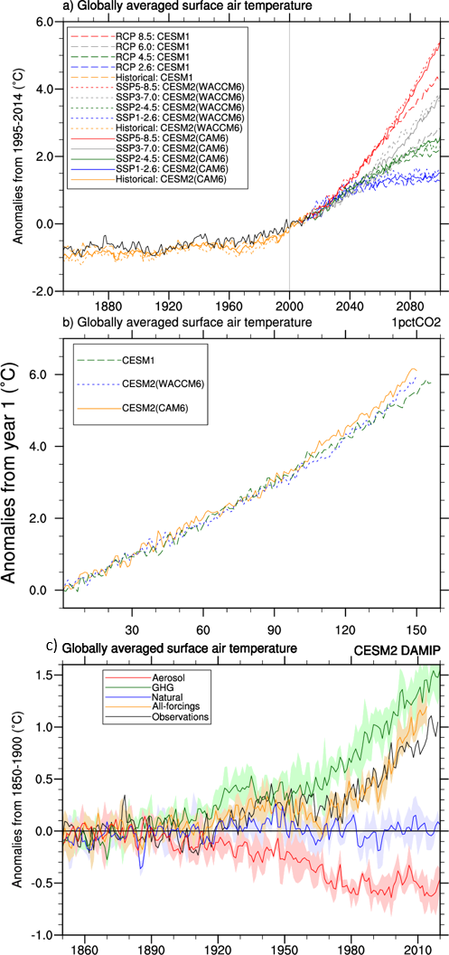
Characteristics of Future Warmer Base States in CESM2
Meehl, G.A, J.M. Arblaster, S. Bates, J.H. Richter, C. Tebaldi, A. Gettelman, B. Medeiros, J. Bacmeister, P. DeRepentigny, N. Rosenbloom, C. Shields, A. Hu, H. Teng, M.J. Mills, and G. Strand, 2020: Characteristics of future warmer base states in CESM2, Earth and Space Science, https://doi:10.1029/2020EA001296. (DOE-funded authors in bold face)
OBJECTIVE
New versions of CESM2 need to be compared to previous versions of CESM1 as well as E3SM to document how the model improvements have affected the response of the model to changes in external forcings. New higher values of equilibrium climate sensitivity (ECS) in CESM2 and E3SM have implications for the model responses to those changes in external forcings.
APPROACH
Analyze new model versions CESM2(CAM6) and CESM2(WACCM6) compared to previous CESM1 and E3SMv1 for future warmer climate simulations and single forcing simulations
IMPACT
• CESM2(CAM6) and CESM2(WACCM6) have higher equilibrium climate sensitivity (ECS), 5.3°C, and 4.8°C respectively, similar to E3SMv1 (5.3°C), but about the same transient climate response (TCR), 2.1°C, and 2.0°C respectively, compared to CESM1
• Future global warming diverges around 2050, with greater warming by end of century in the higher forcing scenarios and in both versions of CESM2 compared to CESM1
• There is more future warming (and greater precipitation increase) in the tropics in the CESM2 versions compared to CESM1
Global surface air temperature anomalies (°C, computed relative to the 1995-2014 base period) for CESM1, CESM2(CAM6), and CESM2(WACCM6), black line denotes observations from HadCRUT4; b) 1% per year CO2 increase experiments (°C) where CO2 doubles around year 70; c) single-forcing DAMIP experiments with CESM2(CAM6), anomalies are computed relative to the 1850-1900 period.

