Slide 1
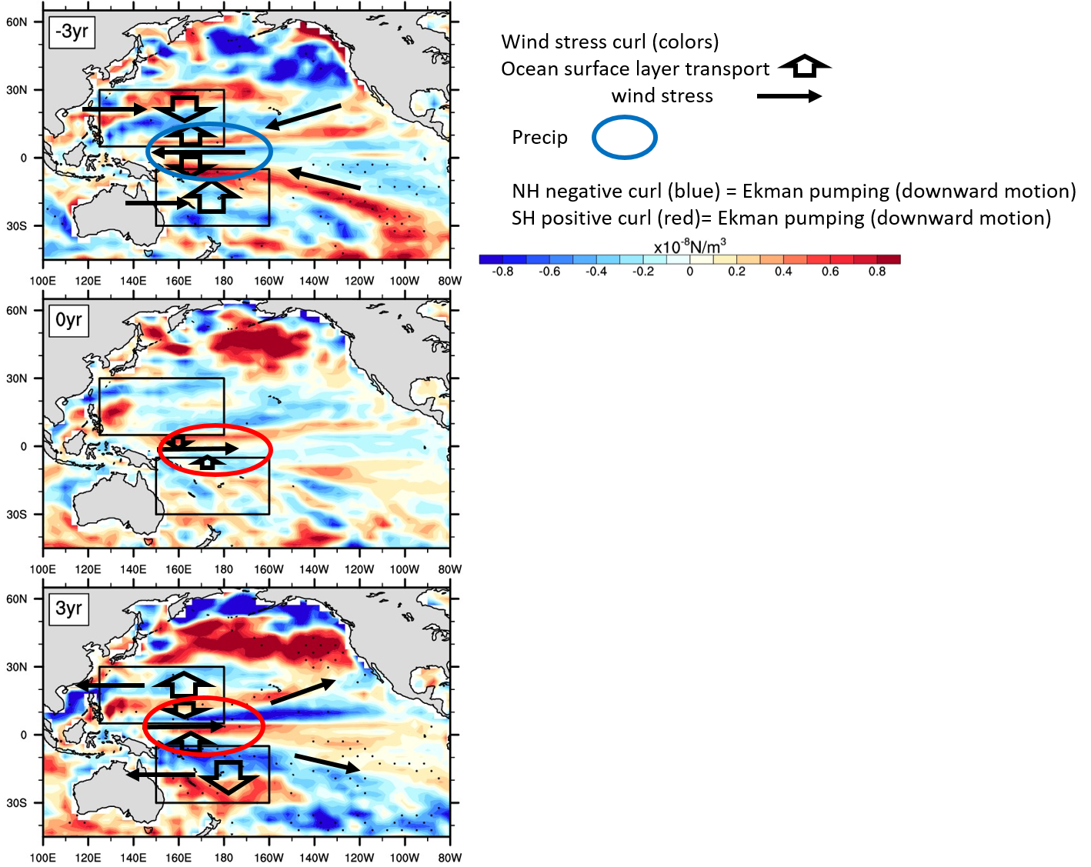
Understanding the role of ENSO events in decadal timescale transitions of the
Interdecadal Pacific Oscillation to improve credibility of decadal predictions
Meehl, G.A., H. Teng, A. Capotondi, and A. Hu, 2021: The role of interannual ENSO events in decadal timescale transitions of the Interdecadal Pacific Oscillation, Climate Dynamics, doi: 10.1007/s00382-021-05784-y. (DOE-funded authors in bold face)
OBJECTIVE
To increase credibility of initialized decadal climate predictions, there must be improved understanding of the processes involved with modes of variability that could contribute to that skill. One candidate involves the build-up of decadal timescale upper ocean heat content in the off-equatorial western tropical Pacific that could then be triggered by El Niño/Southern Oscillation (ENSO) events to contribute to decadal timescale transitions of tropical Pacific SSTs to the opposite phase of the Interdecadal Pacific Oscillation (IPO).
Sequence of composite IPO negative to IPO positive transitions tracking from 3 years before a transition when tropical Pacific SST anomalies are negative (top), the year of the transition (middle), and 3 years after the transition when tropical Pacific SST anomalies are positive (bottom). Background colors are wind stress curl anomalies ; wide arrows indicate irection of meridional ocean transport in surface layer; thin arrows indicate wind stress anomalies; colored ellipses denote areas of negative (blue) or positive (red) precipitation anomalies, boxes indicate key areas for ocean heat content. Stippling indicates 5% significance.
APPROACH
A long pre-industrial control run with CESM1, chosen to tie in to the CESM1 Decadal Prediction Large Ensemble, is analyzed to show that there is a greater chance of ENSO activity to contribute to an IPO transition when off-equatorial western Pacific Ocean heat content reaches either a maximum (for El Niño to contribute to a transition to positive IPO with prolonged above-normal SSTs across the tropical Pacific) or minimum (for La Niña to contribute to a transition to negative IPO) as seen in observations.
IMPACT
Initialized predictions that capture the off-equatorial western Pacific Ocean heat content anomalies would provide improved predictions of decadal-timescale SST anomalies associated with the IPO and associated triggering by ENSO, and thus improve credibility of those predictions.

