Slide 1
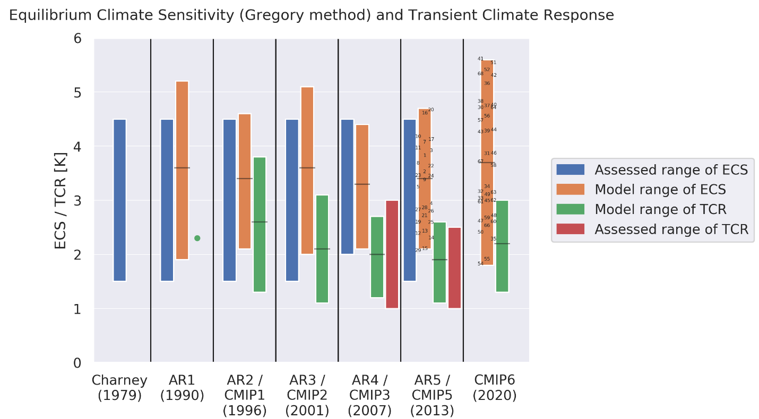
Context for interpreting equilibrium climate sensitivity and transient climate response from the CMIP6 Earth system models
Meehl, G.A., C.A. Senior, V. Eyring, G. Flato, J.-F. Lamarque, R.J. Stouffer, K.E. Taylor, and M. Schlund, 2020: Context for interpreting equilibrium climate sensitivity and transient climate response from the CMIP6 Earth system models, Science Advances, doi:10.1126/sciadv.aba1981. (DOE-funded authors in bold face)
OBJECTIVE
For the current generation of earth system models participating in the Coupled Model Intercomparison Project Phase 6 (CMIP6), the range of equilibrium climate sensitivity (ECS, a hypothetical value of global warming at equilibrium for a doubling of CO₂) is 1.8°C-5.6°C, the largest of any generation of models dating to the 1990s. Meanwhile, the range of transient climate response (TCR, the surface temperature warming around the time of CO₂ doubling in a 1% per year CO₂ increase simulation) for the CMIP6 models of 1.7°C (1.3°C-3.0°C) is only slightly larger than for the CMIP3 and CMIP5 models.
APPROACH
A historical context is provided for interpreting ECS and TCR in the CMIP6 models, and possible reasons are explored for their changes over time.
IMPACT
New sophisticated cloud schemes in the CMIP6 models have improved the overall simulation of clouds, though newly included interacting processes, including cloud-aerosol feedbacks, have increased the uncertainty (increased range) in ECS. Meanwhile, TCR, which is more typically related to the multi-decadal response, has not appreciably changed.
Historical values of ECS and TCR. Assessed values of ECS (blue bars) and TCR (red bars), ranges from models of ECS (orange bars), and TCR (green bars; single value from the AR1 is green dot); numbers are individual model values of ECS from CMIP5 and CMIP6 (available on the ESGF as of March 2020).

